Slide 1



Food Safety Supervisor –
Health Supplements & Nutraceuticals
(Special)
Good Manufacturing, Hygienic and Sanitary Practices for Health Supplements & Nutraceuticals

Slide 2


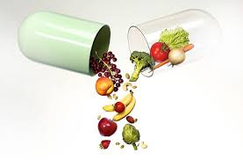




TRAINING PRESENTATION
Good Manufacturing, Hygienic and Sanitary Practices for
Health Supplements & Nutraceuticals
Based on Schedule 4 Part 2, Food Safety and Standards Act

Slide 3
Content – Summary
Nos. | Topics
Section A | Course Objective and Scope
Section B | Implementation of GMP , GHP, HACCP (Module 1-8)
Module 1. | Location, Layout & Facilities
Module 2. | Material Handling – Receiving & Storing
Module 3. | Pre – Production processing
Module 4. | Production
Module 5. | Transportation, Handling & Distribution
Module 6. | Personal Hygiene
Module 7. | Support Services
Module 8. | HACCP

Slide 4
Contents
S. No. | Operational Flow | Sub Sec. Nos. | Heading
1.0 | Location, Layout & Facilities | 1.1 | Location and Surroundings
 |  | 1.2 | Layout and Building design
 |  | 1.3 | Equipment Design & Installation
 |  | 1.4 | Facilities
 |  | 1.5 | Sector Specific Good Manufacturing Practices
2.0 | Material Handling
2.1 | Receiving | 2.1.1 | Control Operations – Supplier Approval & Procurement of Raw Materials
 |  | 2.1.2 | Origin of Botanicals
 |  | 2.1.3 | Botanicals identification & Characterization
2.2 | Storing | 2.2.1 | Storage and Material Control
 |  | 2.2.2 | GHP of Storage Area

Slide 5
Contents
S. No. | Operational Flow | Sub Sec Nos | Heading
3.0 | Pre – Production Processing of Health Supplement & Nutraceuticals
 |  | 3.1 | General Requirements - Operations & Control of Health Supplements & Nutraceutical Processing / Preparation
 |  | 3.2 | Botanical Extract Preparation
4.0 | Production | 4.1 | Health Supplement / Nutraceuticals - Manufacturing of Tablets & Capsules
 |  | 4.2 | Health Supplement / Nutraceuticals - Liquids
 |  | 4.3 | Health Supplement / Nutraceuticals - Powders
 |  | 4.4 | Allergen Management
 |  | 4.5 | Health Supplement / Nutraceuticals - Packaging & Warehousing
 |  | 4.6 | Rework & Control of Non – Conforming Products

Slide 6
Contents
S. No. | Operational Flow | Sub Sec Nos | Heading
5.0 | Transportation | 5.0 | Transportation, Handling & Distribution
6.0 | Personal Hygiene | 6.1 | Health Status , Illness & Injury
 |  | 6.2 | Behavioural & Personal Cleanliness
 |  | 6.3 | Personal Behaviour
 |  | 6.4 | Protective Clothing
 |  | 6.5 | Visitors Control
7.0 7.1 | Support Services
 | Management & Supervision | 7.1 | Management & Supervision
7.2 | Sub Contracting of Operations | 7.2.1 | Terms of Agreement / Contract
 |  | 7.2.2 | Technical Agreement
7.3 | Quality Control & Testing Facilities | 7.3.1 | Specification & Test Methods
 |  | 7.3.2 | Laboratory Personal

Slide 7
Contents
S. No. | Operational Flow | Sub Sec Nos | Heading
7.3 | Quality Control & Testing Facilities | 7.3.3 | Laboratory Facilities & Equipment
 |  | 7.3.5 | Analysis and Validation
 |  | 7.3.6 | Laboratory Documentation
 |  | 7.3.7 | Control of Retention Sample
 |  | 7.3.8 | External Laboratory
 |  | 7.3.9 | Contaminants and Residues
 |  | 7.3.10 | Calibration & Inspection of Measuring & Test Equipments
7.4 | Pest Control Systems | 7.4.1 | General Requirements
 |  | 7.4.2 | Preventing Access
 |  | 7.4.3 | Harbourage & Infestation
 |  | 7.4.4 | Monitoring & Detection
 |  | 7.4.5 | Eradication
 |  | 7.4.6 | Pest Control 4D

Slide 8
Contents
S. No. | Operational Flow | Sub Sec Nos | Heading
7.5 | Cleaning & Maintenance | 7.5.1 | Cleaning & Sanitation
 |  | 7.5.2 | House Keeping
 |  | 7.5.3 | Storage of Cleaning Chemicals
 |  | 7.5.4 | Maintenance
7.6 | Waste Handling | 7.6.1 | Waste Removal
 |  | 7.6.2 | Drainage System
7.7 | Training | 7.7.1 | Awareness Training & Resource Management
 |  | 7.7.2 | Training Program
 |  | 7.7.3 | Refresher Training
7.8 | Record Keeping | 7.8.1 | Audit, Documentation and Records – Self Inspection
 |  | 7.8.2 | Manufacturing Documentation & Records

Slide 9
Contents
S. No. | Operational Flow | Sub – Section No. | Heading
7.9 | Consumer Awareness | 7.9.1 | Product Information & Labeling on Principal Display Panel
 |  | 7.9.2 | Nutrition label Panel
 |  | 7.9.3 | General Labeling
 |  | 7.9.4 | Consumer Awareness
 |  | 7.9.5 | Complaint Handling
7.10 | Traceability & Recall | 7.10.1 | Traceability
 |  | 7.10.2 | Recall Procedures
7.11 | Stability Program | 7.11 | Stability Program
8.0 | HACCP Implementation | 8.1 | Flow Chart for Powders
 |  | 8.2 | Hazard Analysis for Powders
 |  | 8.3 | Flow Chart for Liquids
 |  | 8.4 | Hazard Analysis for Liquids
 |  | 8.5 | Hazard Analysis for Tablets

Slide 10

Section: A

Slide 11

5. Objective
The Food Safety Supervisors (FSS) of Health Supplements and Nutraceutical Industry are to be trained on :
General Requirements on Hygienic and Sanitary Practices, as per “Part II of Schedule 4” of Food Safety and Standards (Licensing & Registration of Food Businesses) Regulations, 2011 under Food Safety & Standard Act, 2006
(http://www.fssai.gov.in/home/fss-legislation/fss-regulations.html)
http://www.fssai.gov.in/home/fss-legislation/food-safety-and-standards-act.html
Industry Best Practices as applicable to Health Supplements and Nutraceuticals.
The GMP/GHP practices will help establishments to prevent physical, chemical & biological hazards resulting from the environment & processing.

Slide 12

6. Scope
Understanding of Food Safety, Good Manufacturing and Good Hygienic practices as laid down in Schedule 4, Part 2 of FSS Regulations 2011, applicable to Health Supplement Industry, in accordance with the size and type of their Unit.

Slide 13

Section B

Slide 14

Implementation of Good Manufacturing Practices ( GMP)
and
Good Hygiene Practices (GHP)
Based on Schedule 4 Part 2 of Food Safety & Standard
(Licensing & Registration of Food Businesses) Regulation, 2011.

Slide 15
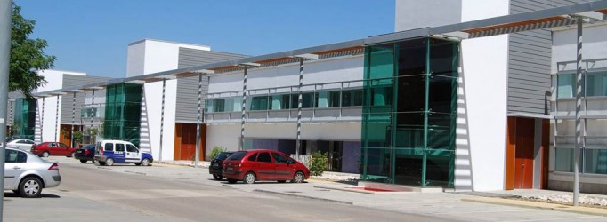
Location, Layout & Facilities
Advance Level
Module 1

Slide 16

Good Manufacturing Practices, Hygienic and Sanitary
Practices for
Health Supplements & Nutraceuticals
Module 1

Slide 17
1.0 Location , Layout & Facilities
S. No. | Operational Flow | Sub Sec No. | Heading
1.0 | Location , Layout & Facilities | 1.1 | Location and Surroundings
 |  | 1.2 | Layout and Building design
 |  | 1.2.1 | General Requirements
 |  | 1.2.2 | Internal Structures
 |  | 1.3 | Equipment Design & Installation
 |  | 1.3.1 | General Requirements
 |  | 1.3.2 | Hygienic Designing of Equipments
 |  | 1.4 | Facilities
 |  | 1.4.1 | Water
 |  | 1.4.2 | Air Quality and Environment conditions
 |  | 1.4.3 | Backup & Uninterrupted Power Supply
 |  | 1.4.4 | Compressed air and other gases
 |  | 1.4.5 | Lighting
 |  | 1.4.6 | Hand washing, drying and sanitizing facilities
 |  | 1.4.7 | Toilet facilities
 |  | 1.4.8 | Changing facilities
 |  | 1.4.9 | Rest and Refreshment rooms
 |  | 1.5 | Sector Specific Good Manufacturing Practices

Slide 18


1.0 Location, Layout & Facilities
1.1 Location and Surroundings
Industry shall be away from following areas -
Environmentally polluted.
Demarcated site boundaries / access control
Emitting wastes, air pollutants, etc.
Prone to infestations of pests.
Where industrial wastes cannot be removed effectively.
Residential / flood prone.
Clean surrounding areas
No stagnant water surrounding the facilities.
Trimmed vegetation.
Adequate measures to protect from any other potential contamination.
Other Requirements

Slide 19

1.0 Location, Layout & Facilities
1.2 Layout & Building Design
1.2.1. General Requirements
Adequate design, construction & maintenance of plant layout to facilitate GMP, GHP and Pest Access.
Adequate working space for :
Logical flow of materials, products and personals
Physical separation of ingredients & nutrients from processed area
Proper placement of equipment for easy operation and maintenance
Inward and outward vehicle movement
Transfer of materials to minimize cross contamination

Slide 20
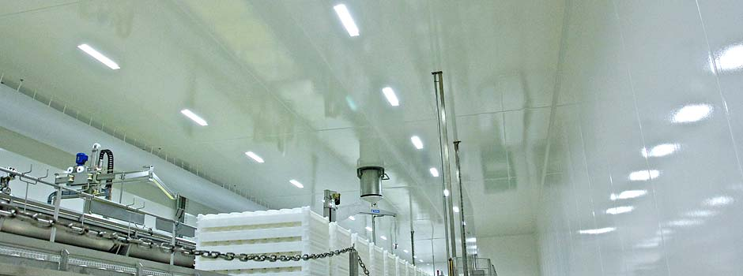
1.0 Location, Layout & Facilities
1.2 Layout & Building Design
1.2.2 Internal Structures
1.2.2.1 Walls , Ceilings and Partitions
  Durable, cleanable, impervious to food, grease & water.
  Free from flaking paint and plaster
  Wall and pillar guards (SS) to avoid daily wear and tear of surfaces.
  Sealed wall & ceiling joints
  Curved / Coved wall and floor joints in process areas.
1.2.2.2 Overhead fixtures
  Suitably protected to avoid
  contamination in case of breakage.

Slide 21
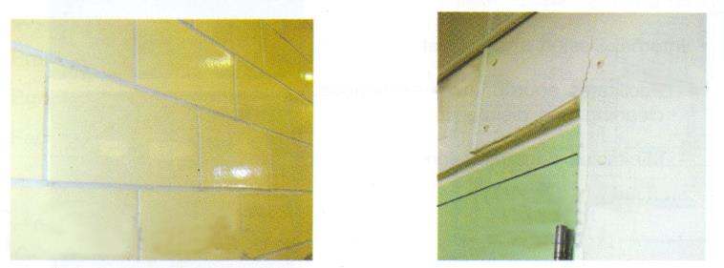


1.0 Location, Layout & Facilities
1.2 Layout & Building Design
Floors, ceilings and walls -
Cleanable, durable, impervious to moisture
Cracks allow bacteria and molds to accumulate

Slide 22
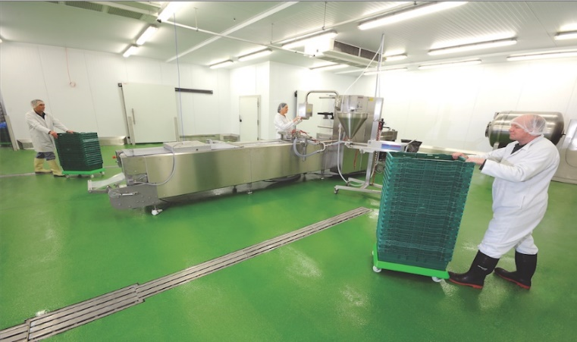
1.0 Location, Layout & Facilities
1.2 Layout & Building Design
1.2.2 Internal Structures
1.2.2.3 Floors
Epoxy coated floors / PU or suitable flooring
Easy to clean & disinfect
Avoid Wet cleaning
Maintained in good repair with no cracks and crevices
Non-slippery, sloped appropriately, to allow adequate drainage
1.2.2.4 Drains
Covered to prevent pest from entering.
Unidirectional flow, in opposite direction to process area
Locked / sealed manholes, inlets, outlets, draining out points

Slide 23
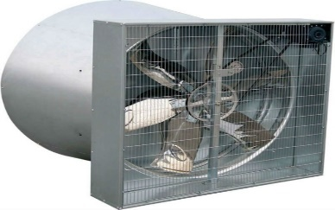
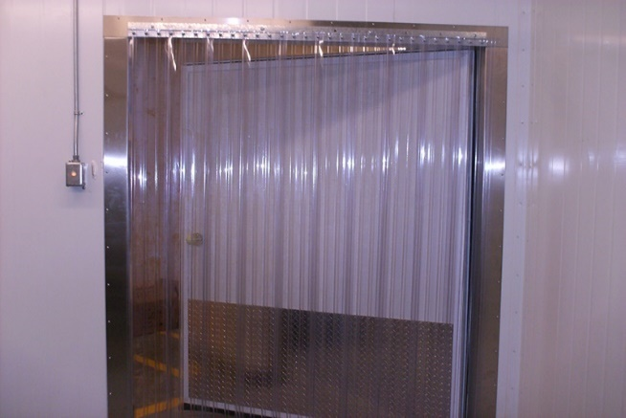
1.0 Location, Layout & Facilities
1.2 Layout & Building Design
1.2.2.5 Doors, Windows, Roof Vents, Exhaust Fans
Doors, Windows, Roof Vents, Exhaust Fans shall be:
Made of smooth and non-absorbent surfaces
Easy to clean and disinfect
Screened with wire-mesh / insect- proof screen
Fitted with automatic closing springs
  Strip PVC / Air curtains at entry / exit points
  Doors with automatic self-closing devices
  Stairs, lift cages and auxiliary structures (viz. platforms, ladders, chutes) shall be situated, constructed and well maintained.
  Gaps between the door and floor, to be closed with rubber strips, polyurethane etc.

Slide 24
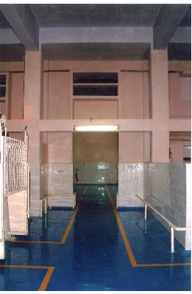
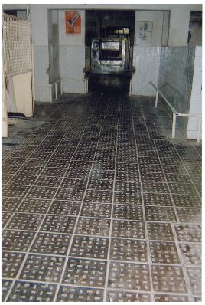
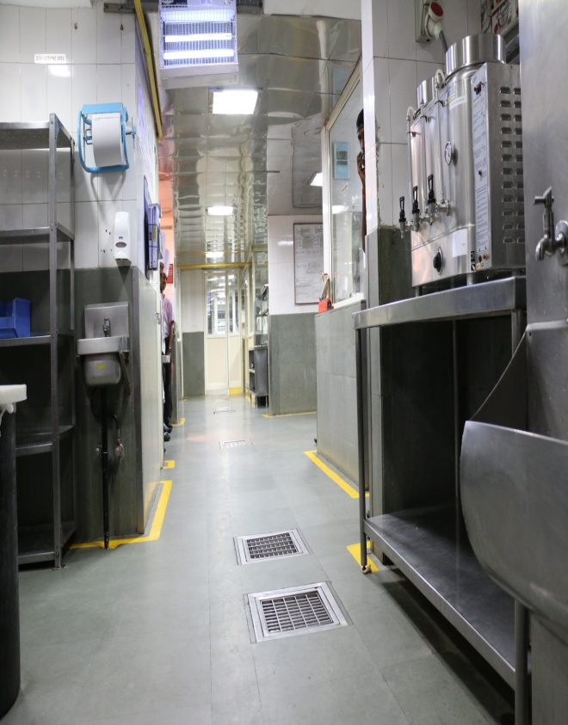
1.0 Location, Layout & Facilities
1.2 Layout & Building Design
Floor with drainage of
appropriate slope
Repaired Floor

Slide 25
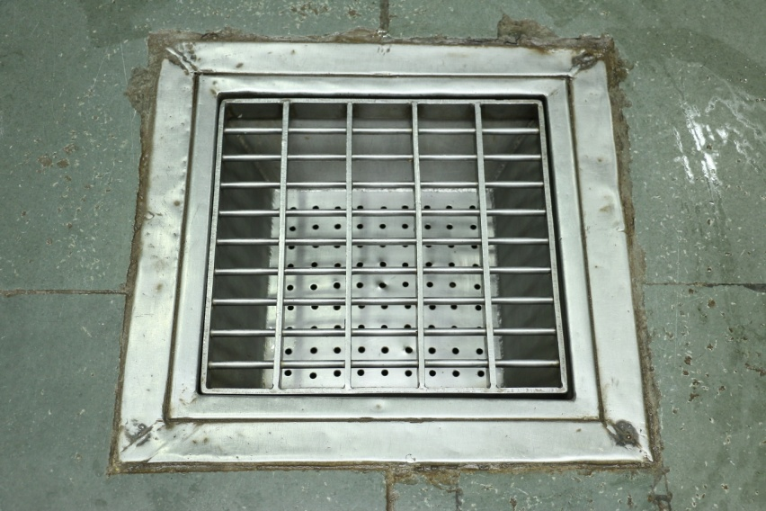
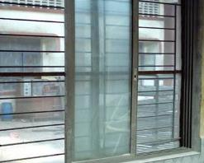
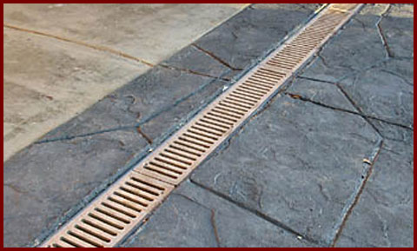
1.0 Location, Layout & Facilities
1.2 Layout & Building Design
Drains should be covered to prevent insects and rodents
Well screened windows
Floor with proper drainage

Slide 26
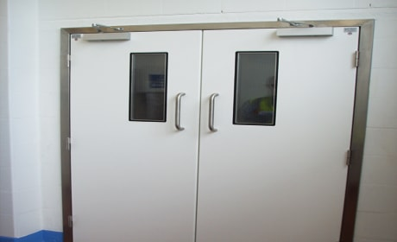
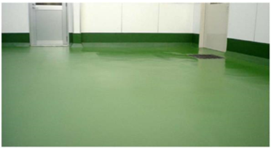
1.0 Location, Layout & Facilities
1.2 Layout & Building Design
Doors made of smooth and
non-absorbent surfaces
Floor with drainage of
appropriate slope

Slide 27
1.0 Location, Layout & Facilities
1.3 Equipment Design & Installation
1.3.1 General Requirements
Equipments and containers
In direct contact with food and
Used for food handling, storage, processing, packing, shall be –
Labelled, identified, stored separately
Designed & fabricated to permit necessary maintenance & periodic cleaning
Kept free from cracks, crevices, open seams etc.
Made of impervious, corrosion free, food grade material
Placed away from wall & above the floor to facilitate cleaning.
Covered with proper fittings / clean gauze net / material of fine texture.
Kept away from obnoxious fumes & gases to avoid contamination.

Slide 28
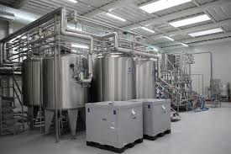
1.0 Location, Layout & Facilities
1.3 Equipment Design & Installation
1.3.2 Hygienic Designing of Equipments
Hygienic designing of Manufacturing vessels, pipes and material handling equipments to have :
Well bonded and smooth material in use.
Sloped pipes, with no dead-legs or right-angled bends,
Domed tops, curved sides, conical bases for vessels/tanks.

Slide 29
1.0 Location, Layout & Facilities
1.3 Equipment Design & Installation
Flexible hoses with smooth internal surface for easy cleaning & sanitary fittings easy to connect / disconnect hoppers.
Adequate control measures and appropriate facilities for cleaning, disinfecting & sanitizing.
Clean-In-Place (CIP) to be adopted, wherever possible.
Remove Defective equipment
Clear identification with Status if any equipment cannot be removed

Slide 30
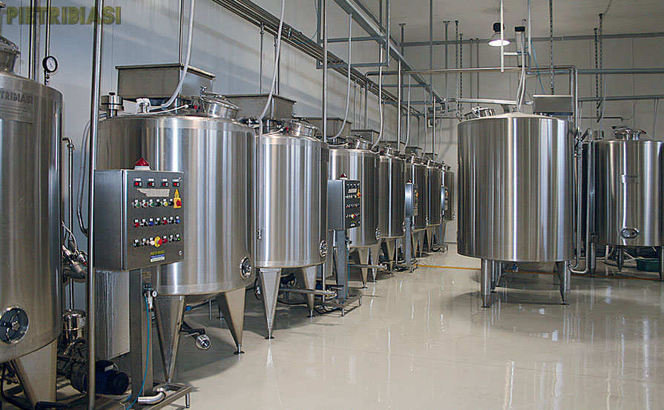
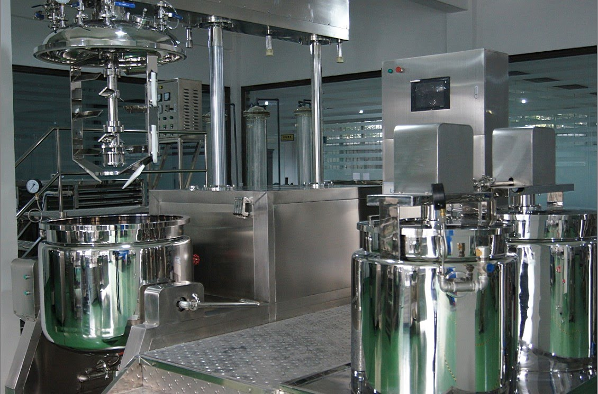
1.0 Location, Layout & Facilities
1.3 Equipment Design & Installation
Hygienically designed Equipments made of Stainless Steel

Slide 31
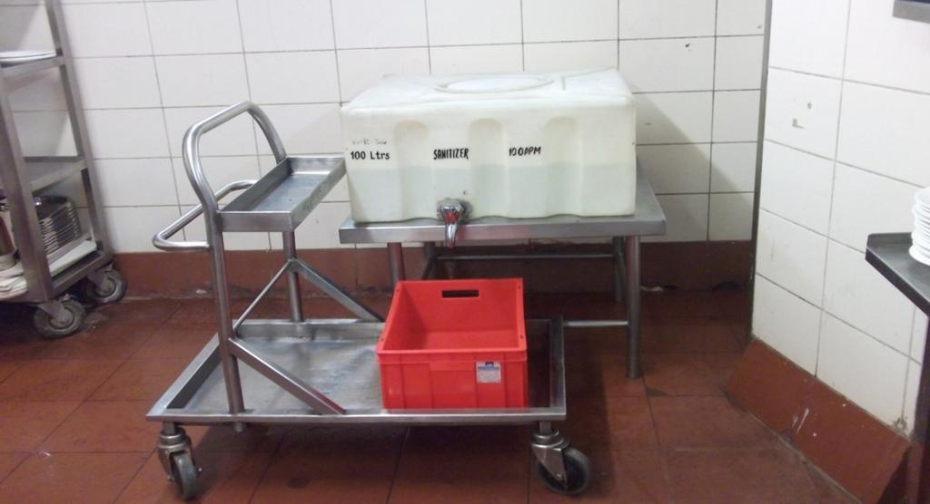
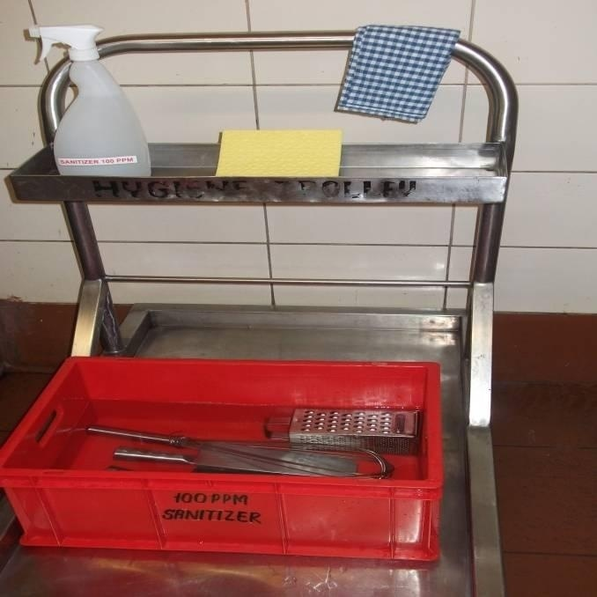
1.0 Location, Layout & Facilities
1.3 Equipment Design & Installation
Sanitizing of Equipments

Slide 32
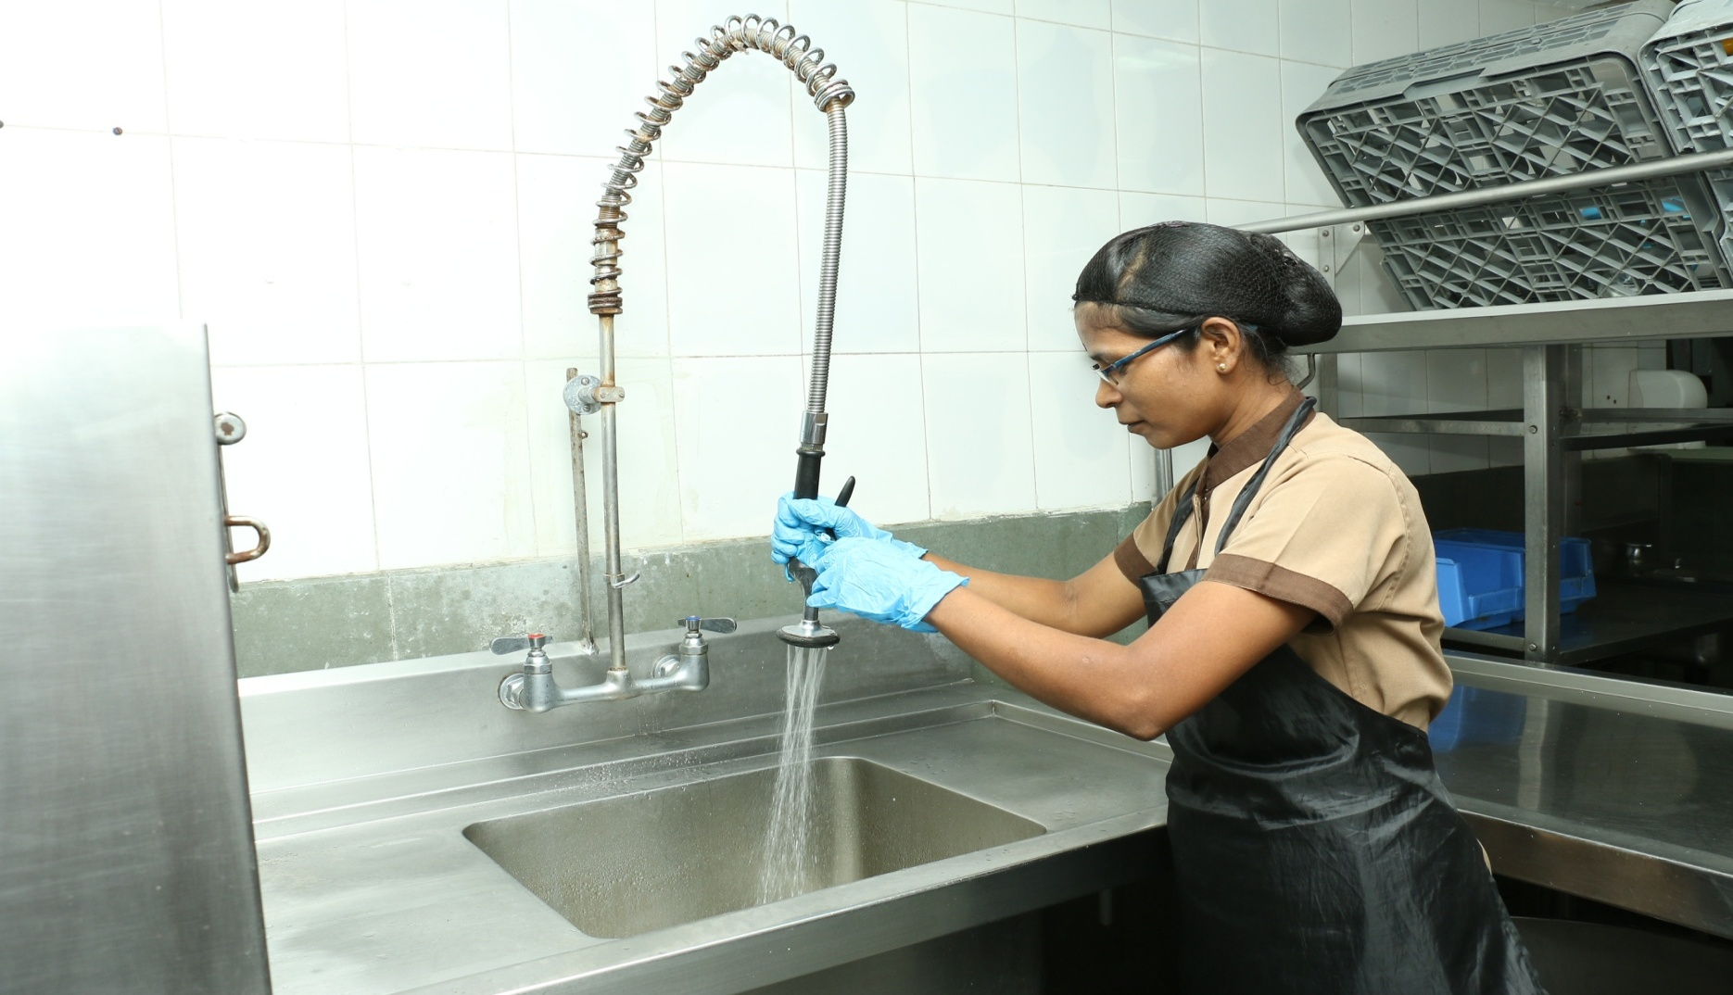
1.0 Location, Layout & Facilities
1.3 Equipment Design & Installation
Cleaning of Equipments

Slide 33
1.0 Location, Layout & Facilities
1.4 Facilities
The facilities that play vital role in a Health Supplement & Nutraceutical industry are :
1.4.2 Air Quality and Environment conditions
1.4.3 Backup & Uninterrupted Power Supply
1.4.4 Compressed air and other gases
1.4.5 Lighting
1.4.6 Hand washing, drying and sanitizing facilities
1.4.7 Toilet facilities
1.4.8 Changing facilities
1.4.9 Rest and Refreshment rooms
1.4.1 Water

Slide 34

1.0 Location, Layout & Facilities
1.4 Facilities
1.4.1 Water :
Adequate supply of potable water for
Steam / Ice generation as product ingredient.
Equipment, food contact surfaces & plant cleaning
Semi-annual analysis against IS 10500 Standard.
Water storage tanks and pipes
Non-toxic, corrosion resistant material
Periodic cleaning and maintenance
Records of cleaning & inspection.
Covered to prevent pest access & other extraneous matter.

Slide 35
1.0 Location, Layout & Facilities
1.4 Facilities
1.4.1 Water :
Regular monitoring of water filters.
Potable recycled water if used in processing or as an ingredient.
Pumps, valves, storage and distribution skids of non-reactive, non-corrosive, non-leaching material and sanitary in design.
Clearly separated and identifiable process & cleaning water lines.
Color coded potable and non-potable water pipelines.
Cleaning of non-food contact (i.e. Refrigeration & Fire Fighting) equipments with Non potable water
Identification to prohibit reflux of non-potable water into potable water systems

Slide 36
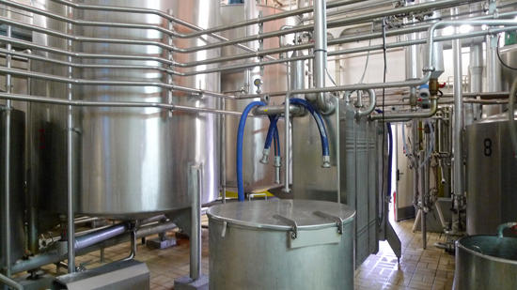
1.0 Location, Layout & Facilities
1.4 Facilities
1.4.1 Water :
Multiple Water lines and CIP System in place

Slide 37
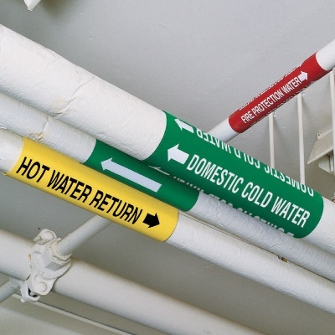
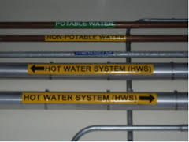
1.0 Location, Layout & Facilities
1.4 Facilities
1.4.1 Water :
Colour coding of water pipes to avoid contamination
Demarcation of pipelines

Slide 38
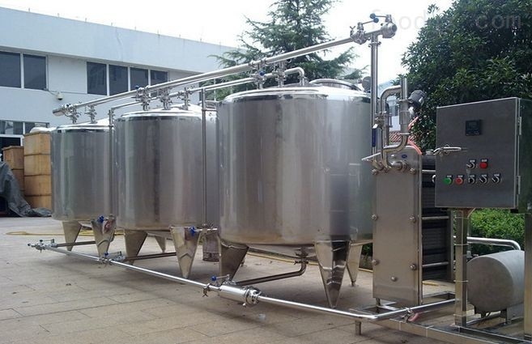
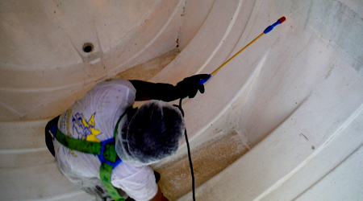
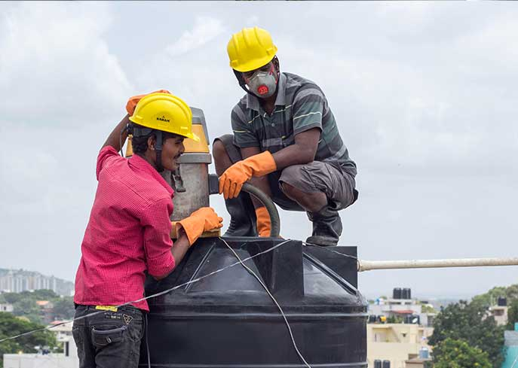
1.0 Location, Layout & Facilities
1.4 Facilities
1.4.1 Water :
Periodic cleaning and maintenance of water storage tanks to prevent contamination

Slide 39
1.0 Location, Layout & Facilities
1.4 Facilities
1.4.2 Air Quality, Environment conditions & Ventilations
Material sampling/Dispensing/Product contact area/Process equipment storage area – ISO 8 with RLAF ISO 5
Temperature not more than 25° C
Relative Humidity (RH) should not more than 60% +/- 5%
Negative pressure at process equipment washing area w.r.t processing area

Slide 40
1.0 Location, Layout & Facilities
1.4 Facilities
1.4.2 Air Quality, Environment conditions & Ventilations
RM storage area – environment conditions as per requirement
FG storage area – as per the established stability studies
Microbiology Lab / Analytical Laboratory –
ISO 8 with LAF ISO 5, (Dedicated AHU provided for Microbiological Lab);
Temp. not more than 25° C and Relative Humidity (RH) not more than
60%+/- 5%.

Slide 41
1.0 Location, Layout & Facilities
1.4 Facilities
1.4.2 Air Quality, Environment conditions & Ventilation
Gradation of surrounding area to maintain integrity of the targeted class.
Well designed ventilation system to ensure air does not flow from contaminated to clean areas.
Adequate Differential Pressure to be maintained between different classified areas
Accessible system for cleaning, filter changing and maintenance.
Recommended differential pressure in adjacent areas shall be min 0.5 mm of Water Column (5-10 psi).

Slide 42
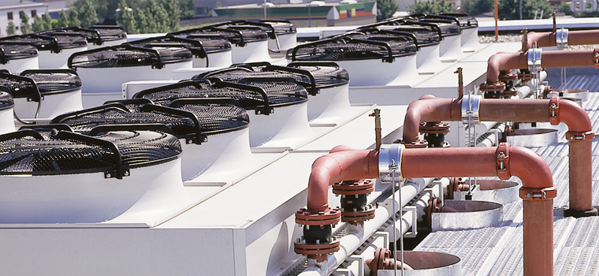
1.0 Location, Layout & Facilities
1.4 Facilities
Periodical examination of air filters, exhaust and air intake ports to check physical filter integrity.
Periodic air quality monitoring.
Adequately designed Natural / Mechanical ventilation systems, including Heating, Ventilation and Air Conditioning (HVAC) systems / air-conditioning, Air filters, Exhaust fans, to prevent air flow from contaminated to clean areas.

Slide 43
1.0 Location, Layout & Facilities
1.4 Facilities
1.4.3 Backup & Interrupted Power Supply
Ensure uninterrupted power supply via appropriate means to facilitate smooth processing and production.
1.4.4 Compressed air and other gases (Carbon Dioxide, Nitrogen, etc.)
Appropriate construction & maintenance of gas systems used in manufacturing and / or filling to prevent contamination
From food contact approved source if intended for direct / incidental product contact
Filtered to remove dust, oil and moisture to ensure microbial quality.
Checked at least once in a year.
Use of Oil free Compressed air system is recommended.

Slide 44
1.0 Location, Layout & Facilities
1.4 Facilities
1.4.5 Lighting
Adequate natural / artificial to enable operating in hygienic manner.
Ensure that resulting colour is not misleading.
Covered light fixtures to prevent contamination during breakages.
Adequate intensity (i.e. the lux level) as per the nature of operation.
For Example: USFDA Food Code 2017
Atleast 540 LUX where employee is working with Food & Equipment/Utensils like Knives, Slicers etc.
Atleast 215 LUX for Handwashing, warehousing, & toilet areas.
Atleast 108 LUX for Food storage areas & Cleaning areas.

Slide 45
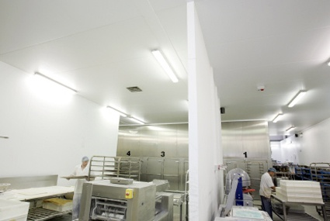
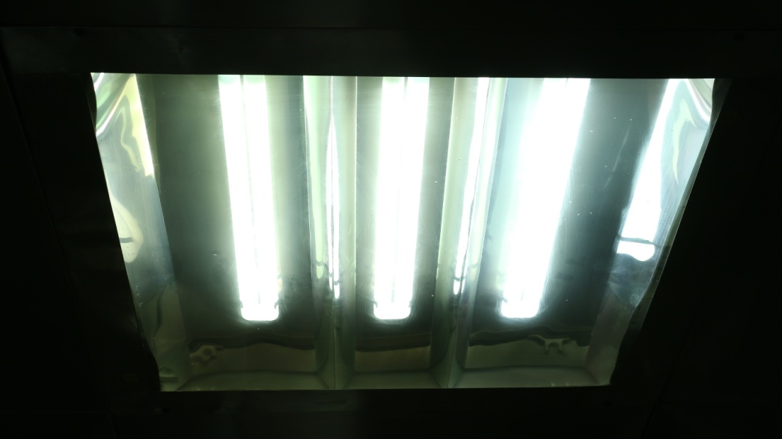
1.0 Location, Layout & Facilities
1.4 Facilities
1.4.5 Lighting
Proper lighting facility in the work area
Lights shall be covered

Slide 46
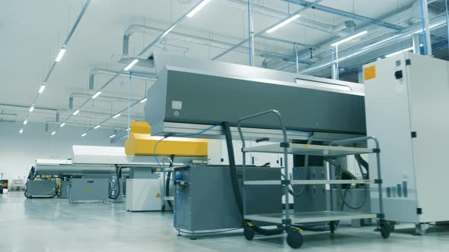
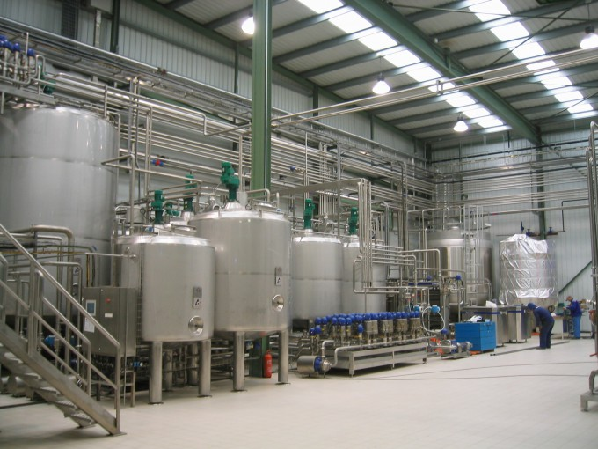
1.0 Location, Layout & Facilities
1.4 Facilities
1.4.5 Lighting
Lighting at Dry and Liquid Storage Areas

Slide 47
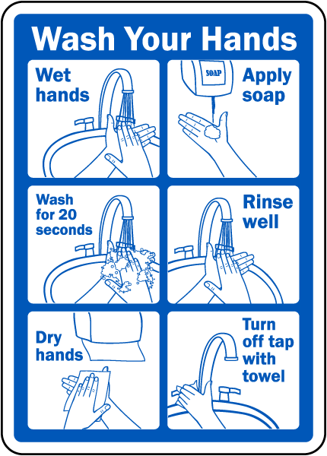
1.0 Location, Layout & Facilities
1.4 Facilities
1.4.6 Hand washing, Drying and Sanitizing facilities
Hand Wash facility > Hot & Cold Water provision > Process area entrance.
Hand washing steps & pictorials near hand wash stations.
Suitable hygienic means of hand drying (viz. Paper towels, Hand driers, etc.)
Non - Perfumed liquid soap
Elbow / Foot operated taps

Slide 48
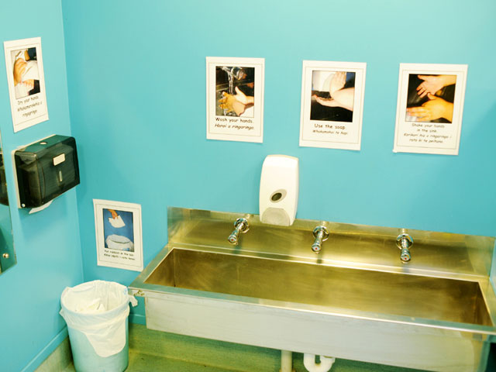
1.0 Location, Layout & Facilities
1.4 Facilities
1.4.6 Hand Washing, Drying and Sanitizing facilities
Provision of sufficient dispensers / receptacles in case paper towels are used
Covered paper towel rolls from top
Foot operated dustbins to throw used-paper towels.
Self-drying hand sanitizer. (Eg: IPA 70%)

Slide 49
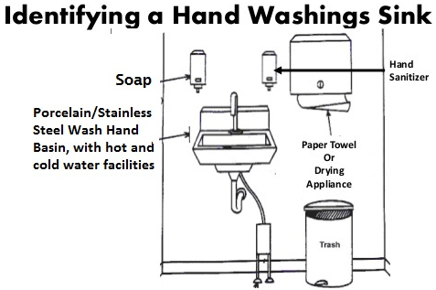
1.0 Location, Layout & Facilities
1.4 Facilities
1.4.6 Hand Washing, Drying and Sanitizing facilities

Slide 50
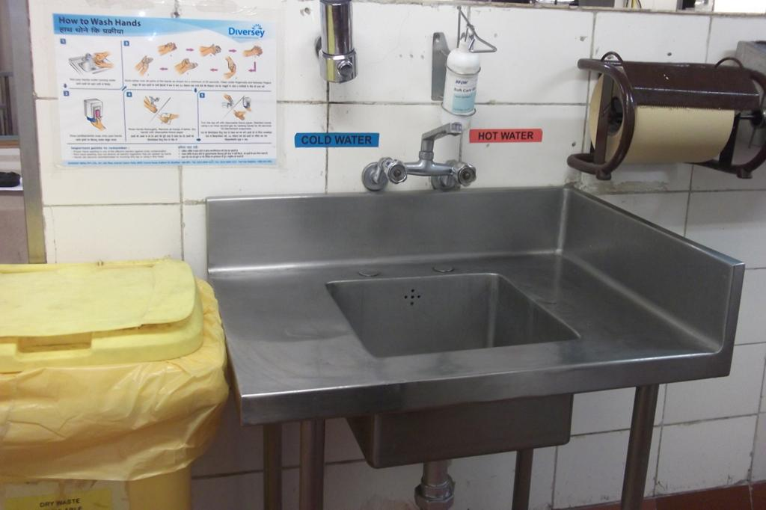
1.0 Location, Layout & Facilities
1.4 Facilities
1.4.6 Hand Washing, Drying and Sanitizing facilities

Slide 51

1.0 Location, Layout & Facilities
1.4 Facilities
1.4.7 Toilet Facilities
Separate & not directly connected to storage and manufacturing areas.
Separate and adequate number of toilets / urinals for male and female. (1:25 ratio for facility : employee to be followed).
Adequate water supply in toilets and urinals.
Use of potable water at toilet wash basin stations.
Clean and sanitized toilet facilities during working hours.
Designed to ensure hygienic removal of waste matter.
Well lit, ventilated and not opening directly into food handling areas.

Slide 52
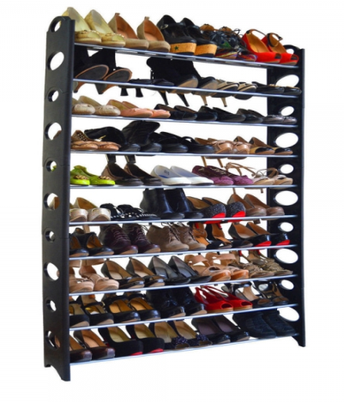
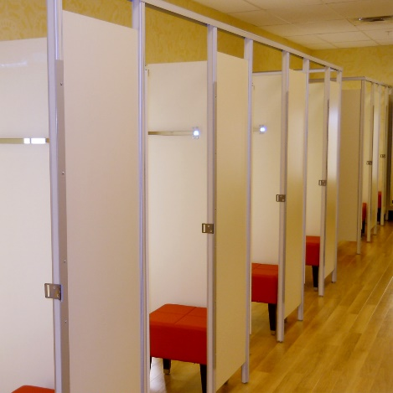
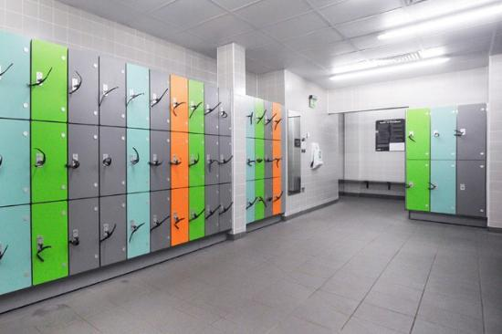
1.0 Location, Layout & Facilities
1.4 Facilities
1.4.8 Changing Facilities
  Periodical cleaning of Factory Footwear; not to be used for external purposes.
  Separate areas to keep home personal clothes and company uniforms.
  Suitable & sufficient to change clothes, keep personal belongings and Street footwear.
  Lockers to keep personal belongings

Slide 53

1.0 Location, Layout & Facilities
1.4 Facilities
1.4.9 Rest and Refreshment rooms
Rest & Refreshment Rooms, separate from other areas
Not leading directly to manufacturing & storage areas
Provision for Staff canteens to store prepared food
Employees’ shall consume their food in Refreshment Rooms only
Display board (in English or local language) mentioning’ Dos’ and ‘Don’ts’ at prominent place inside the premises

Slide 54


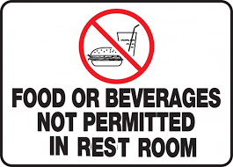
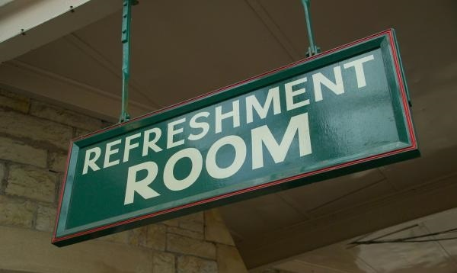
1.0 Location, Layout & Facilities
1.4 Facilities
Separate lockers for men and women for changing work clothes
Food shall be consumed in Refreshment Room and not in Rest Room

Slide 55
1.0 Location, Layout & Facilities
1.5 Sector Specific Good Manufacturing Practices
Movement of material and methods, from high to low risk area.
High risk area: Product/material exposed areas (e.g. processing, primary processing, filling, sampling, dispensing areas), having controlled temperature, humidity and differential pressure.
Monitoring of High risk zone for microbial loads.
Low risk area: The area where product/ material is not exposed like, Washing, Secondary Packing area, Warehouse.

Slide 56

Material Handling
Advance Level
Module 2

Slide 57

Good Manufacturing Practices, Hygienic and Sanitary
Practices for
Health Supplements & Nutraceuticals
Module 2

Slide 58
2.0 Material Handling
S. No. | Operational Flow | Sub Sec No. | Heading
2.0 | Material Handling
2.1 | Receiving | 2.1.1 | Control Operations – Supplier Approval & Procurement of Raw Material & Packing Material
 |  | 2.1.2 | Origin of Botanicals
 |  | 2.1.3 | Botanical identification & Characterization
2.2 | Storing | 2.2.1 | Storage & Material Control
 |  | 2.2.2 | GHP of Storage Area

Slide 59
2.0 Material Handling
2.1 Receiving
2.1.1 Control Operations –
Supplier Approval & Procurement of Ingredients, Nutrients & Packing material
Supplier Quality Development Programme - criteria for selection, approval, review and ongoing approval
RM, Processing aids, ingredients procurement from internally approved suppliers.
Procurement from FSSAI / FDA / Ayush licensed / registered supplier or licensed from other regulatory authorities.
Evaluation of approved supplier w.r.t quality supplied & other factors
Ingredients/Nutrients receiving according to storage & processing capacity of the processing plant.

Slide 60
2.0 Material Handling
2.1 Receiving
All Raw Materials, Ingredients, Packaging Materials and Process aids shall
Conform to all regulatory standards,
Be inspected and
Sorted before processing.
Procedures to confirm incoming materials meet specifications through:
Certificate Of Analysis,
Visual inspection,
Laboratory testing,
Review of label for allergens etc.
Food grade certificates for applicable food processing aids, packaging & other food contact material from suppliers.
Records of material used in processing & their source of procurement for traceability.

Slide 61

2.0 Material Handling
2.1 Receiving
Check all bulk tankers & containers for seal integrity and cleanliness as per inspection checklist at the time of receipt.
Check packaged RM for ‘expiry date’/’best before’/’use by date’, packaging integrity and storage conditions.
Vehicle inspection

Slide 62

2.0 Material Handling
2.1 Receiving
2.1.2 Origin of Botanicals
Name and origin to be ascertained
Traceable by a Batch no. / Shipment ID
Written confirmation for relevant batches / lots to show compliance with Good Agricultural Principles & Collection Practice, w.r.t identification and traceability.

Slide 63

2.0 Material Handling
2.1 Receiving
2.1.3 Botanical identification & Characterization
Plant part used in the botanical preparation to be ascertained like -
Whole plant / Underground parts / Specific Roots / Rhizome / Tuber / Bulb
Aerial parts of the plant / Stem Specific / Bark / Leaves / Flower / Fruit / Seed
Method for confirming identification of unprocessed
botanical:
Microscopic / Macroscopic examination
Chromatographic / Spectroscopic examination
Other characteristic assay
Physical tests
The traceability records shall be available since point of plant growth.

Slide 64

2.0 Material Handling
2.2 Storing
2.2.1 Storage & Material Control
Ensure design & construction of
Buildings, fixtures, equipment of product storage areas
Vehicles at loading & unloading bays is maintained to facilitate the operations being carried out and to prevent damage to the stored material.

Slide 65
2.0 Material Handling
2.2 Storing
Storing of RM, Ingredients, PM, FG in clean, dry, well ventilated spaces protected from external contamination.
Suitable & adequate stacking of Materials and products
Aisles to be kept clear and avoid temporary storage of materials.
Receiving and dispatch bays designed to protect receipt of materials and dispatch of products from extreme weather.
Provision of cleaning incoming material containers (where necessary) at receipt.

Slide 66
2.0 Material Handling
2.2 Storing
Adequate spacing between pallets to ensure sufficient ventilation.
Periodic visual checks of storage, w.r.t structural integrity and infestations.
Separate sampling & dispensing area in the warehouse.
Storage of RM and ingredients as mentioned on label / specified by vendor.
Storage of printed PM in safe, dry, dust free and separate & secured manner.
Monitoring of Storage area temperatures and RH at stipulated frequency.

Slide 67
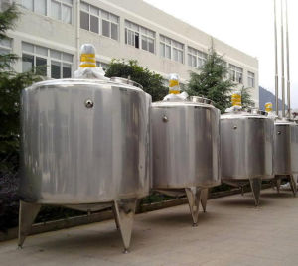
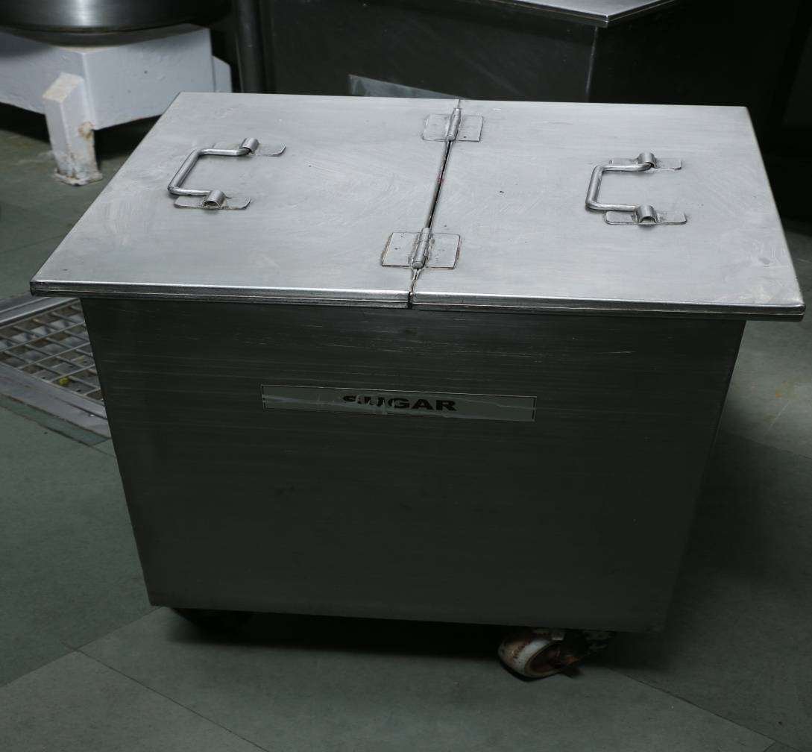
2.0 Material Handling
2.2 Storing
Identification of all materials and product w.r.t Lot Number, to maintain the traceability.
Identification to be easily accessible / visible even when the material/product is stacked.
RM as fresh material of botanical origin shall be stored in a separate dedicated area with appropriate controls.
Storage Tanks Storage Containers

Slide 68

2.0 Material Handling
2.2 Storing
2.2.2 GHP of Storage Area
Cleaning of Storage Areas:
Cleaning of Storage premises and equipment at defined frequency.
Cleaning schedules and procedures to specify materials and methods for cleaning
Define cleaning SOP and maintain records to demonstrate compliance.
Regular inspection of stores for cleanliness and good housekeeping.
Separate storage of cleaning materials to avoid cross-contamination.

Slide 69
2.0 Material Handling
2.2 Storing
Damaged, Rejected & Recalled Goods
Damaged goods –
Placed in a designated place,
Physically segregated from Good stocks,
Properly labelled.
Re-packing of only those products which are properly inspected & acceptable.
Package to contain minimum durability (Best Before) date in case goods of different production codes are re-packed in same outer-packaging.

Slide 70

2.0 Material Handling
2.2 Storing
Physical segregation & identification of:
Recalled or returned products
Lots rejected for re-working or
Lots for recovery of materials or disposal
Maintain Recall records, as per FSSR recall regulation 2017.

Slide 71
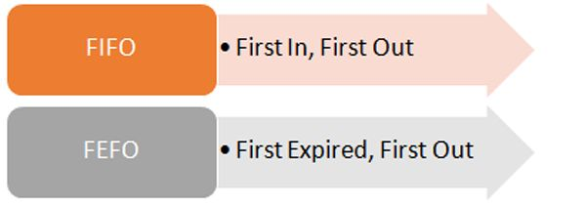

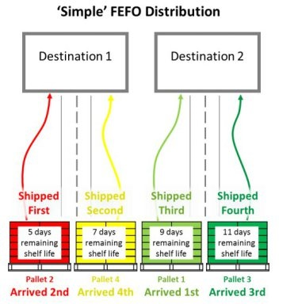
2.0 Material Handling
2.2 Storing
Stock Management

Slide 72
2.0 Material Handling
2.2 Storing
Access Control :
Restricted access to authorized personnel / only those personnel working in material and product storage areas.
Air curtain at all entrances and exits opening to the external environment
Controlled access to High Risk Zone through Biometrics.
Provision of buffer area / pass box / air lock between storage area and manufacturing area in case they are directly connected

Slide 73

Pre – Production Processing Advance Level
Module 3

Slide 74

Good Manufacturing Practices, Hygienic and Sanitary
Practices for
Health Supplements & Nutraceuticals
Module 3

Slide 75
Contents
S. No. | Operational Flow | Sub Sec No. | Heading
3.0 | Pre – Production Processing of Health Supplement & Nutraceuticals | 3.1 | General Requirements - Operation & Control of Health Supplement & Nutraceutical Processing / Preparation
 |  | 3.2 | Botanical Extract Preparation

Slide 76
3.0 Pre – Production Processing of Health Supplement & Nutraceuticals
3.1 General Requirements - Operations & Control of Health Supplement & Nutraceutical Processing / Preparation
Documentation, implementation & display of Flow diagram, Process operation SOPs.
Maintaining and implementing Process & Product changeover SOP.
Appropriate coding, maintaining records for daily process w.r.t critical parameters like temperature / vacuum etc., for traceability.
Maintain test records (w.r.t critical parameters) of Intermediate in-process samples
Equipment cleaning schedule to be maintained.
Systems to prevent contamination of food by foreign bodies
Use of suitable detection or screening devices during processing operation.

Slide 77

3.0 Pre – Production Processing of Health Supplement & Nutraceuticals
Access to High Risk Processing Areas only via changing facility.
Allergen management should be in place.
Supervision of all manufacturing operations by authorised technical person.
Trained personnel to carry out critical steps like selection, weighing and measuring of RM, under the direct supervision of authorised technical person.
Adequate space away from processing areas for
cleaning and storing of mobile equipments,
containers & cleaning materials.

Slide 78
3.0 Pre – Production Processing of Health Supplement & Nutraceuticals
Place incoming materials and finished products at designated areas after receipt, until released for use or distribution.
Proper handling of Intermediate and bulk products purchased.
Avoid processing of different products simultaneously / consecutively in the same room unless there is no risk of mix-up or cross-contamination.
Label (w.r.t Name of product, Batch No. & Size, Stage of Mfg.) contents of all vessels & containers used in manufacture & storage during entire processing
Each label to be initialled and dated by the authorised technical staff.

Slide 79

3.0 Pre – Production Processing of Health Supplement & Nutraceuticals
3.2 Botanical Extract Preparation
Preparation derived from botanical extracts :
Extracts, Comminuted, Powdered herbal substance; Essential oil; Expressed juice; Processed exudate; Others)
Form of Botanical Extracts :
Standardized extract / Quantified extract / Other extract
Markers present in botanical extract
/ other preparation :
Active markers / Analytical markers

Slide 80

3.0 Pre – Production Processing of Health Supplement & Nutraceuticals
3.2 Botanical Extract Preparation
When Standards of Botanicals are not specified, the purity criteria generally accepted by pharmacopoeias, are either /or :
Indian Pharmacopoeia,
Ayurvedic Pharmacopoeia of India,
Specifications of Bureau of Indian Standards ,
Quality Standards of Indian Medicinal Plants,
Indian Council of Medical Research,
British Pharmacopoeia,
United States Pharmacopoeia,
Food Chemical Codex,
Joint Food and Agriculture Organization
World Health Organization
Expert Committee on Food Additives
CODEX Alimentarius may be adopted by
food Business operators.

Slide 81

Production of
Health Supplement & Nutraceuticals
Advance Level
Module 4

Slide 82

Good Manufacturing Practices, Hygienic and Sanitary
Practices for
Health Supplements & Nutraceuticals
Module 4

Slide 83
Contents
S. No. | Operational Flow | Sub – Sec No. | Heading
4.0 | Production | 4.1 | Manufacturing Requirements for Tablets & Capsules
 |  | 4.1.1 | Manufacture of dosage forms (tablets and capsules)
 |  | 4.1.2 | Sifting, Mixing, Blending and Granulation
 |  | 4.1.3 | Compression of Tablets
 |  | 4.1.4 | Coating of Tablets
 |  | 4.1.5 | Encapsulation - Capsules (Powder & Liquid Filled)
 |  | 4.1.6 | Printing (Tablets and Capsules)
 |  | 4.1.7 | Packaging of Tablets & Capsules
 |  | 4.2 | Manufacturing Requirements for Liquids
 |  | 4.2.1 | Building and Equipment
 |  | 4.2.2 | Water Treatment
 |  | 4.2.3 | Manufacturing Process for Liquids
 |  | 4.3 | Manufacturing of Powder

Slide 84
Contents
S. No. | Operational Flow | Sub – Sec No. | Heading
4.0 | Production | 4.4 | Allergen Management
 |  | 4.4.1 | Allergen Handling
 |  | 4.4.2 | Allergen Control and Management
 |  | 4.5 | Packaging & Warehousing
 |  | 4.5.1 | Packaging
 |  | 4.5.2 | Warehousing
 |  | 4.6 | Rework & Control of Non – Conforming Products

Slide 85
4.0 Production of Health Supplement & Nutraceuticals
4.1 Manufacturing Requirements for Tablets & Capsules
4.1.1 Manufacture of dosage forms (tablets and capsules)
Dust Control systems while processing of dry materials.
‘Line clearance’ before processes like dispensing, mixing, sieving, blending, compression, packing.
Testing & quality release all raw materials & ingredients prior to dispensing as per BOM (Bill of Material).
Sifting of all ingredients for dry product.
Protection of material from metal, wood particles, plastics & other foreign particles.
Air conditioning to prevent cross contamination
Prevent leakage of lubricants from any part of the equipment into the product.

Slide 86
4.0 Production of Health Supplement & Nutraceuticals
4.1 Manufacturing Requirements for Tablets & Capsules
Clean air-extraction nozzles of compressed air.
Filtering of air entering the driers.
Installation of Filters in air extraction systems with discharge points to retain dust and protect the factory and local environment.
Examine screens, sieves, punches and dies for wear and tear / for breakage before and after each use.
Regular monitoring of pressure differentials between rooms for any deviation.
Production / Quality Department to be intimated in case of deviation.
Validate & specify the maximum period of storage of the bulk materials.

Slide 87

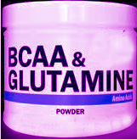


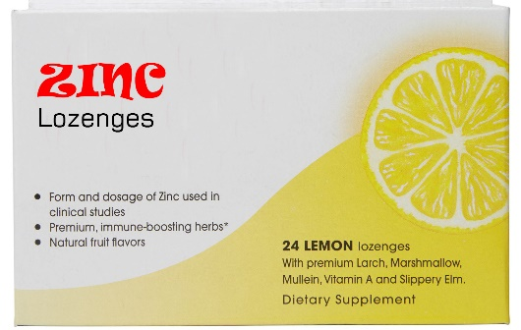


4.1.1 Manufacture of dosage forms (tablets and capsules)
4.0 Production of Health Supplement & Nutraceuticals
4.1 Manufacturing Requirements for Tablets & Capsules
What are dosage forms : to be taken in measured small quantities

Slide 88
4.0 Production of Health Supplement & Nutraceuticals
4.1 Manufacturing Requirements for Tablets & Capsules
4.1.2 Sifting, Mixing, Blending and Granulation
Integrity check of sieves before and after the process
Periodical examination of residues from sieving operations
Lead free sieves and screens of the sieving equipment
Do not use filter bags fitted to fluid-bed drier for different products, without being washed in-between use.
Use only product specific bags in case of highly potent or sensitizing products
Record Blending time and RPM

Slide 89
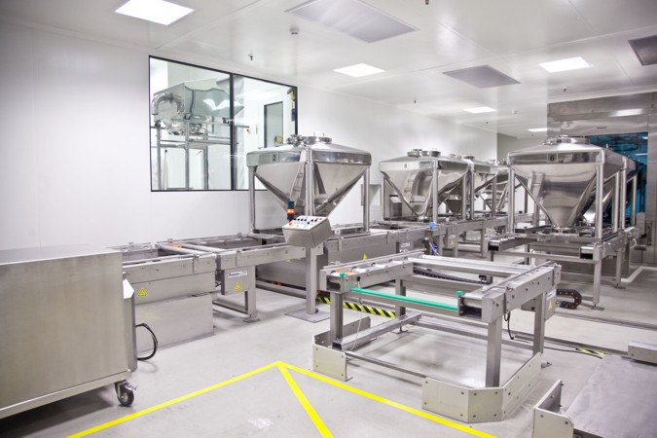
4.0 Production of Health Supplement & Nutraceuticals
4.1 Manufacturing Requirements for Tablets & Capsules
4.1.2 Sifting, Mixing, Blending and Granulation
Installation of dust extractors or air handling unit for sifting and blending equipment.
Recording of mixing time, temperature, ampere load and other key parameters in BMR.

Slide 90
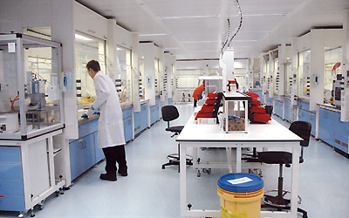
4.0 Production of Health Supplement & Nutraceuticals
4.1 Manufacturing Requirements for Tablets & Capsules
4.1.3 Compression of Tablets
Inspection of tablets at fixed intervals for pharmacopeia parameters like:
Appearance,
Weight variation,
Disintegration,
Hardness,
Friability,
Thickness and
Contamination by lubricating oil.
Compression Stations with individual Cubicles

Slide 91

4.0 Production of Health Supplement & Nutraceuticals
4.1 Manufacturing Requirements for Tablets & Capsules
Record results in BMR (Batch Manufacturing Record)
Installation of each Compression machine in separate cubicles in own enclosed air controlled environment.
Collect tablets into clean, labelled containers.

Slide 92

4.0 Production of Health Supplement & Nutraceuticals
4.1 Manufacturing Requirements for Tablets & Capsules
4.1.3 Compression of Tablets
De-dusting & monitoring of tablets for foreign materials
Weighing equipment calibration for in-process monitoring of tablet weight variation.
Procedures for detecting out of limit tablets
In-process control to ensure products remain within specification.
Label all in-process material, granules and tablets to prevent mix up during compression process.
Isolate rejected / discarded tablets in identified containers and record quality in BMR.

Slide 93

4.0 Production of Health Supplement & Nutraceuticals
4.1 Manufacturing Requirements for Tablets & Capsules
4.1.4 Coating of Tablets
Document & Record the preparation and use of coating solution.
Use freshly prepared coating solution to minimize the risk of microbial growth.
Filtered air of suitable quality to be supplied for drying of coating pans
Suitable exhaust system and environmental control (temperature, humidity) measures in this area.

Slide 94


4.0 Production of Health Supplement & Nutraceuticals
4.1 Manufacturing Requirements for Tablets & Capsules
4.1.5 Encapsulation - Capsules (Powder & Liquid Filled)
Storage of Capsules, under adequate environmental conditions preventing from excessive heat and moisture.
Temperature NMT 25°C and RH NMT 60 +/- 5% or as per the product requirements.

Slide 95

4.0 Production of Health Supplement & Nutraceuticals
4.1 Manufacturing Requirements for Tablets & Capsules
4.1.6 Printing (Tablets and Capsules)
Post printing tablets and capsules must be released only after approval from QC.
Use of only edible grade colours and suitable printing ink
Take special care to avoid product mix-up during printing of tablets and capsules.
Adequate segregation of operation, when different products / different batches of the same product, are printed simultaneously

Slide 96
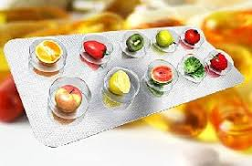
4.0 Production of Health Supplement & Nutraceuticals
4.1 Manufacturing Requirements for Tablets & Capsules
4.1.7 Packaging of Tablets & Capsules
Testing & release of PM prior to dispensing against laid down standards.
‘Line clearance’ before dispensing PM & before a new packing operation starts.
Removal of tablets/capsules/foils of previous batch before new packaging operation starts.
Independent check of packaging equipment, prior to commencement of any operation.
Vacuum test – for integrity of individual package, to ensure leak proof seal integrity and its records.

Slide 97

4.0 Production of Health Supplement & Nutraceuticals
4.1 Manufacturing Requirements for Tablets & Capsules
4.1.7 Packaging of Tablets & Capsules
Packing uncoated tablets on equipment designed to minimize risk of cross-contamination.
Packaging in an isolated area.
Inspection of package for defects i.e. misprint, No-fill, cuts on foil, missing tablets & improper sealing.
Record & destroy outdated / obsolete primary PM / printed PM.
No fill detectors, metal detectors and check wares –
In-case tablets / capsules in the pack can’t be seen or
Can’t be counted after primary packing,
For empty packets and broken tablets.

Slide 98

4.0 Production of Health Supplement & Nutraceuticals
4.1 Manufacturing Requirements for Tablets & Capsules
4.1.7 Packaging of Tablets & Capsules

Slide 99
4.0 Production of Health Supplement & Nutraceuticals
4.2 Manufacturing Requirements for Liquids
4.2.1 Building and Equipment
Designed, constructed and maintained to suit the manufacturing of Liquids.
Entry through double door airlock facility.
Use of fly catcher and/or air curtain.
Cleaning and sanitation of manufacturing area after every production batch.
Cleaning of containers and droppers with high pressure air, water and steam jets.

Slide 100

4.0 Production of Health Supplement & Nutraceuticals
4.2 Manufacturing Requirements for Liquids
Well designed equipment to prevent accumulation of residual microbial growth
Designed & installed to easily clean and sanitize tanks, containers, pipe work and pumps.
.
Smooth and washable furniture made up of SS.
Equipments’ material contact parts of SS or any other appropriate material

Slide 101

4.0 Production of Health Supplement & Nutraceuticals
4.2 Manufacturing Requirements for Liquids
4.2.2 Water Treatment
Well defined operation system of water treatment and maintenance
Use of UV, heat, re-circulation and chemical sanitation to minimize risk of microbial contamination.
Flushing after every chemical sanitation.
De-mineralized water qualifying Indian Pharmacopeia IP 14.
Periodic monitoring of water quality for chemical and microbiological contaminants.

Slide 102
4.0 Production of Health Supplement & Nutraceuticals
4.2 Manufacturing Requirements for Liquids
Non-fibre shedding clothing for manufacturing personnel
Monitoring & specified mixing and filling processes
Ensure uniformly homogenous product before, during interrupted stoppage & while filling process is going on.
Specify maximum period of storage conditions in Master Formula.
Validation of maximum period of storage time of a product in the bulk stage.

Slide 103

4.0 Production of Health Supplement & Nutraceuticals
4.2 Manufacturing Requirements for Liquids
Use of appropriate emulsifier & stirrer (during filling) to maintain homogeneity of emulsion & suspensions.
Adequately filtered air supply to primary packaging area.

Slide 104

4.0 Production of Health Supplement & Nutraceuticals
4.3 Manufacturing of Powder
Controlled environment conditions of the manufacturing area
Adequately filtered & conditioned air
ISO 14644-1/2:2015 : Recommended air quality in processing area
Airlock system at the entrance to production area
Insectocutors installed outside the airlock
Exhaust system to effectively remove vapours, fumes, smoke, floating dust particles

Slide 105

4.0 Production of Health Supplement & Nutraceuticals
4.3 Manufacturing of Powder
Well designed equipment preventing even accidental contamination of product
Separate section for Primary packing.
Prohibit using rags / dusters during cleaning / drying of In-use process equipment or accessories.
Use of potable water in compounding.
Sieving of powders before use.

Slide 106

4.0 Production of Health Supplement & Nutraceuticals
4.4 Allergen Management
4.4.1. Allergen Handling : Major Allergens are –
Cereals containing gluten; i.e., wheat, rye, barley, oats, spelt or their hybridized strains and products of these;
Crustacean and products of these;
Eggs and egg products;
Fish and fish products;
Soybeans and products of these;
Milk and milk products (lactose included);
Peanut, tree nuts and nut products; and
Sulphite in concentrations of 10 mg/kg or more

Slide 107








Cereals containing gluten
Tree nuts and nut products
Sulphite in concentrations
of 10 mg/kg or more
Allergens
Crustacea and products of these
Milk and milk products
Eggs and egg products
Peanuts, soybeans and
products of these

Slide 108

Common Food Allergens

Slide 109

4.0 Production of Health Supplement & Nutraceuticals
4.4 Allergen Management
4.4.2. Allergen Control and Management
Display of allergens at relevant places for awareness amongst employees.
Allergen management training for employees.
Labelling of allergenic raw materials
Flow of ingredients from non-allergen to allergen using areas.
Maintain ingredient flow from non-allergen to allergen using areas.
Run non-allergen before allergen ingredient containing products

Slide 110


4.0 Production of Health Supplement & Nutraceuticals
4.4 Allergen Management
4.4.2. Allergen Control and Management
Designated storage for all allergic foods or ingredients.
Separate storage for partially used and completely sealed & identified allergic packets.
Dedicated scoops, utensils for specific allergens.
Thorough cleaning between allergic and non-allergic containing product manufacture.

Slide 111

4.0 Production of Health Supplement / Nutraceuticals
4.5 Packaging & Warehousing
4.5.1 Packaging
The PM used shall
Be robust and secure enough to provide protection
Prevent spoilage
Prevent contamination during transit
Follow labelling regulatory requirements.
Use of food grade packaging materials
Conformation to BIS standards for aluminium, tin and plastic PM
Use of non-toxic packaging materials or gases
Packaging section >> High care zone >> Restricted Access >> Controlled via changing facility.
Clean protective clothing and footwear before entry.

Slide 112

4.0 Production of Health Supplement / Nutraceuticals
4.5 Packaging & Warehousing
PM Inspection before use to prevent using damaged/defective/contaminated packaging
Effective procedures to confirm if reusable containers are properly cleaned & sanitized, repaired or replaced, as appropriate, before re-use.
Daily Calibration like weighing scale & record keeping.
Separate designated area (sides closed), hygienic environment for filling and packaging

Slide 113

4.0 Production of Health Supplement / Nutraceuticals
4.5 Packaging & Warehousing

Slide 114

4.0 Production of Health Supplement / Nutraceuticals
4.5 Packaging & Warehousing
Immediate labelling post filling and sealing
Follow proper procedures to avoid any mix-ups or mislabelling
4.5.2 Warehousing
Storage at least 18 inch away from walls and off the floor (viz. on pallets, racks, cupboards)
Clean, dry, ventilated & hygienic condition
Temperature & humidity control systems using calibrated equipment. Record Keeping
Designated, Segregated, Enclosed areas (as per Central and State Legislations) for hazardous, toxic substances and flammable material storage

Slide 115

4.0 Production of Health Supplement / Nutraceuticals
4.6 Rework & Control of Non – Conforming Products
A non-conforming product can be detected through
Incoming material inspection
During normal testing and inspection activities
Internal defect findings
Internal audits
External audits
Customer complaints

Slide 116


4.0 Production of Health Supplement / Nutraceuticals
4.6 Rework & Control of Non – Conforming Products
Adequate storage, segregation, identification, handling & labelling to maintain product safety, quality, traceability and regulatory compliance
Maintain traceability records
Protect stored material from exposure to microbiological, chemical or extraneous matter contamination

Slide 117

4.0 Production of Health Supplement / Nutraceuticals
4.6 Rework & Control of Non – Conforming Products
Where Rework / Non-conforming / Market return is incorporated as an “In-process” step;
Acceptable quantity,
Process step
Method of addition, including necessary pre-processing stages, shall be pre-defined.
Adequate controls during removal of product from filled packages to avoid contamination
SOPs for handling rework or non-confirming products.
Document additional inspection of Rework / Reprocess / In-process / Finished product

Slide 118

Transport, Handling & Distribution of
Health Supplements & Nutraceuticals
Advance Level
Module 5

Slide 119
Good Manufacturing Practices, Hygienic and Sanitary
Practices for
Health Supplements & Nutraceuticals
Module 5

Slide 120

Contents
S. No. | Operational Flow | Sud Section No. | Heading
5.0 | Transportation | 5.0 | Transportation, Handling & Distribution
Handling & Distribution facility at Warehouse

Slide 121

5.0 Transportation, Handling & Distribution
Adequate transportation facilities enabling adequate cleaning and/or disinfection.
Maintain all conveyances and/or containers in clean and good repair condition.
Vehicle Inspection for –
general cleanliness,
freedom from moisture,
foreign materials,
damage,
insect or rodent infestations,
objectionable odours or
other forms of contamination.
SOP to handle damaged goods during storage or distribution.

Slide 122


5.0 Transportation, Handling & Distribution
Adequate security for deterring and preventing any tampering with goods.
Keep docks, railway sidings, bays, driveways, etc. free from accumulation of debris and spillage.
Well equipped/battery driven fork lift & trucks to prevent fume/fuel contamination.
FIFO / FEFO during dispatches of FG

Slide 123

Personal Hygiene
Advance Level
Module 6

Slide 124

Good Manufacturing Practices, Hygienic and Sanitary
Practices for
Health Supplements & Nutraceuticals
Module 6

Slide 125
Contents
S. No. | Operational Flow | Sub Section No. | Heading
6.0 | Personal Hygiene | 6.1 | Health Status , Illness & Injury
 |  | 6.2 | Personal Cleanliness
 |  | 6.3 | Personal Behaviour
 |  | 6.4 | Work wear & Grooming
 |  | 6.5 | Visitors Control

Slide 126

6.0 Personal Hygiene
6.1 Health Status, Illness & Injury
On Joining & Annual Medical examination by a registered medical practitioner
Free from any infections and other communicable diseases
Vaccination against enteric group of diseases as per recommended schedule of vaccine
Record keeping
Prevent sick / ill personnel (suffering from disease) from handling / coming in contact with the finished goods
“Fit to Join” Certificate from Medical Practitioner before re-joining, post illness/injury
Control practice of self – medication by handlers / employees

Slide 127


6.0 Personal Hygiene
6.1 Health Status, Illness & Injury
Must report – jaundice, diarrhoea, vomiting, fever, sore throat with fever, visibly infected lesions, (boils, cuts or sores) and discharges from ear, eye or nose.
Medical examination of clinically or epidemiologically indicated food handler apart from periodic medical examination.
Water-proof dressings to cover open cuts, wounds or burns
Reporting of lost dressings to supervision
Use of brightly coloured & metal detectable dressings

Slide 128

6.0 Personal Hygiene
6.2 Personal Cleanliness
Maintain high degree of personal cleanliness
Wear clean and washable / disposable work clothing, (including headgear, nose mask, shoe cover and where appropriate, neck-covering and/or beard snood).
Use of clean, food grade gloves (like nitrile gloves) maintained in good condition
Restrict use of protective clothing specific to manufacturing areas or hygiene purpose elsewhere.
Trimmed & clean fingernails without nail polish.
Handwashing displays at appropriate locations.

Slide 129

6.0 Personal Hygiene
6.2 Personal Cleanliness
Hand washing, drying & sanitizing before entering in process areas, where required
before starting work;
after handling chemicals;
after handling incompatible food products (e.g., ingredients/work in process/finished goods) or contaminated materials;
after breaks;
after using toilet facilities.
after using telephone / cell phones,
after smoking in designated areas etc.
after coughing or sneezing or blowing their nose;

Slide 130

6.0 Personal Hygiene
6.3 Personal Behaviour
Effective personal hygiene programme to follow hygienic behaviour and habits.
Prohibit unhygienic practices like smoking, chewing / eating, sneezing / coughing over unprotected food, spitting.
Avoid personal effects such as jewellery, watches, pins, perfumes in process area.
Provision of personal lockers to keep personal belongings.
Do not keep food contact tools and equipment in personal lockers.

Slide 131
6.0 Personal Hygiene
6.4 Work wear & Grooming
Wear work clothing fit for purpose, clean and in good condition (e.g. free from rips, tears or fraying material) while entering exposed products area.
Restrict clothing mandated for Health supplement / Nutraceuticals / Hygiene purposes elsewhere.
Work wear without buttons and outside pockets above waist level.
Work wear laundered at predefined intervals.
Adequate coverage by work wear to prevent contamination via hair, perspiration, etc.
Well designed & maintained personal protective equipment to prevent product contamination.

Slide 132







ALWAYS WEAR PROTECTIVE CLOTHING
HEAD GEAR
APRON
BEARD NET
SHOE COVER
GLOVES
FACE MASK

Slide 133

6.0 Personal Hygiene
6.5 Visitors Control
Implement Visitors Policy
Display of any specific hygiene requirements
Adherence to all personal hygiene provisions by visitors
Visitor identity cards to control visitor’s access into restricted areas.

Slide 134

Support Services
Advance Level
Module 7

Slide 135

Good Manufacturing Practices, Hygienic and Sanitary
Practices for
Health Supplements & Nutraceuticals
Module 7

Slide 136
Contents
7.0 Support Services
Sec. No. | Operational Flow | Sub –Sec No. | Heading
7.1 | Management & Supervision | 7.1 | Management & Supervision
7.2 | Sub Contracting of Operations | 7.2.1 | Terms of Agreement / Contract
 |  | 7.2.2 | Technical Agreement
7.3 | Quality Control & Testing Facilities | 7.3.1 | Specification & Test Methods
 |  | 7.3.2 | Laboratory Personal
 |  | 7.3.3 | Laboratory Facilities & Equipment
 |  | 7.3.4 | Sampling
 |  | 7.3.5 | Analysis & Validation
 |  | 7.3.6 | Laboratory Documentation
 |  | 7.3.7 | Control of Retention Samples
 |  | 7.3.8 | External Laboratory
 |  | 7.3.9 | Contaminants & Residues
 |  | 7.3.10 | Calibration & Inspection of Measuring & Test Equipments

Slide 137
Contents
7.0 Support Services
S. No. | Operational Flow | Sub –Sec No. | Heading
7.4 | Pest Control Systems | 7.4.1 | General Requirements
 |  | 7.4.2 | Preventing access
 |  | 7.4.3 | Harbourage and Infestation
 |  | 7.4.4 | Monitoring and Detection
 |  | 7.4.5 | Eradication
 |  | 7.4.6 | Pest control – 4 D method
7.5 | Cleaning & Maintenance | 7.5.1 | Cleaning & Sanitation
 |  | 7.5.2 | House Keeping
 |  | 7.5.3 | Storage and handling of Cleaning Chemicals
 |  | 7.5.4 | Maintenance
7.6 | Waste Handling | 7.6.1 | Waste Removal
 |  | 7.6.2 | Drainage System

Slide 138
Contents
7.0 Support Services
S. No. | Operational Flow | Sub Sec No. | Heading
7.7 | Training | 7.7.1 | Awareness Training & Resource Management
 |  | 7.7.2 | Training Program
 |  | 7.7.3 | Refresher Training
7.8 | Record Keeping | 7.8.1 | Self Inspection
 |  | 7.8.2 | Manufacturing Documentation & Records
7.9 | Product Information & Consumer Awareness | 7.9.1 | Product Information & Labeling on Principal Display Panel
 |  | 7.9.2 | Nutrition Label Panel
 |  | 7.9.3 | General Labeling
 |  | 7.9.4 | Consumer Awareness
 |  | 7.9.5 | Complaint Handling
7.10 | Traceability & Recall | 7.10.1 | Traceability
 |  | 7.10.2 | Recall Procedures
7.11 | Stability Programs | 7.11 | Stability Programs

Slide 139

7.1 Management & Supervision

Slide 140

7.0 Support Services
7.1 Management & Supervision
Educated, skilled, trained or experienced personnel (engaged in process & quality control operations) to perform assigned functions.
Managers and supervisors :
Must have necessary knowledge and skills to judge potential risks and
Take necessary action to rectify deviations.
Provide trainings & resources to employees to develop food safety culture at plant.
Employees performing specialized job functions : Government / Recognized industry certified

Slide 141

7.0 Support Services
7.1 Management & Supervision
Maintain SOP for GMP systems compliance
Routine verification of compliance through records /checklists
Verify Records of Certification
Follow SOP’s based on – 5W’s & 1H as:

Slide 142



7.0 Support Services
7.1 Management & Supervision

Slide 143

7.2 Sub – Contracting of Operations
7.2.1 Terms of Agreement/ Contract
7.2.2 Technical Agreement

Slide 144

7.0 Support Services
7.2 Sub Contracting of Operations
7.2.1 Terms of Agreement/ Contract
Technical Agreement - The written contract between two parties.
Detailed specifications for RM, Intermediates and FG
Clearly emphasized GMP requirements.
Identified & agreed Quality control, record transfer, coding rejection, dispute, and complaint procedures.
Cover following aspects in contractual conditions to ensure quality stds. and GMPs:
Safe production of health supplement / Nutraceuticals within the manufacturing environment.
Legal Agreement to cover product specific parameters with criteria of acceptance or rejection w.r.t product, process, pack and delivery

Slide 145

7.0 Support Services
7.2 Sub Contracting of Operations
7.2.1 Terms of Agreement/ Contract
To agree upon:
Sampling plans of FG to be used in case of dispute.
Methods for determining expiration date and confirmatory documents.
Objective methods of examination & subjective measurements to conform to recognised and accepted standards
Period for record keeping
Evaluating adequacy of control resources, systems, methods & records of manufacturer
Well documented amendments or improvements
Recording confirmation of acceptance of the completed work

Slide 146

7.0 Support Services
7.2 Sub Contracting of Operations
7.2.2 Technical Agreement
Defines responsibilities of each party.
Attention to clarifying the responsibilities of each party in relation to key / critical activities, such as:
Scope of instructions, shall comprise of :
Approval and release of raw materials,
Changes to the formulation and processes,
Release specification,
Release of the finished product and its transportation,
Complaints, withdrawal and recall procedures,
Procedure for notifying the Contract Giver of any abnormality during the contracted process.

Slide 147

7.0 Support Services
7.2 Sub Contracting of Operations
7.2.2 Technical Agreement
Section on ownership of intellectual material (e.g. formulae, specific processing techniques), with any restrictions on transfer of information to third parties.
Identify items of possible confidentiality
Mutually agreed upon appropriate safeguards.

Slide 148

7.3 Quality Control & Testing Facilities
7.3.1 Specification and Test Methods
7.3.2 Laboratory Personnel
7.3.3 Laboratory Facilities and Equipment
7.3.4 Sampling
7.3.5 Analysis and Validation
7.3.6 Laboratory Documentation
7.3.7 Control of Retention Samples
7.3.8 External Laboratory
7.3.9 Contaminants & Residues
7.3.10 Calibration and Inspection of
Measuring and Test Equipments

Slide 149

7.0 Support Services
7.3 Quality Control & Testing Facilities
QC programme to include inspection and testing of incoming RM and FG
Availability of laboratory facility, trained and competent testing personnel.
Testing through FSSAI notified external accredited lab, in absence of in-house lab
Testing through In-house / external accredited / lab notified by FSSAI, in case of complaints or feedback on the product
Maintain test records of Incoming RM / Bulk chemicals / Ingredients test records.
During in-house pathogen testing, micro lab shall not open directly into process area.
Autoclave tested sample and remnant before disposing off.
Periodic calibration of laboratory equipment

Slide 150

7.0 Support Services
7.3 Quality Control & Testing Facilities
7.3.1 Specification and Test Methods
Authorized specifications for RM, PM , In-process/Intermediate material and FG
Specifications should include :
Description of materials,
Designated name of material / product and code reference
Directions for sampling and testing
Qualitative and quantitative requirements with acceptance limits
Storage conditions and any special handling precautions
Shelf-life
Validated methods for testing of material / product
Analytical method verification for the compendia / pharmacopeia methods.
Use of scientifically valid test methods published internationally (e.g. AOAC, BAM, USP, FCC etc.)

Slide 151

7.0 Support Services
7.3 Quality Control & Testing Facilities
7.3.2 Laboratory Personnel
Appropriate in number with desired skills
Clean protective clothing appropriate to the tasks being carried out.
7.3.3 Laboratory Facilities and Equipment
Appropriate & calibrated laboratory equipments & instrumentation for analysis
Operating procedures for each instrument / equipment
Well designed & equipped to suit the operations required.

Slide 152

7.0 Support Services
7.3 Quality Control & Testing
Sufficient space for storage of chemicals, media, glassware, documents, samples and records,
Trained personnel operating the equipment
Maintain records of each service and calibration for each equipment,
Provide adequate waste bins.
Control step to verify whether instrument / equipment is functioning accurately.

Slide 153
7.0 Support Services
7.3 Quality Control & Testing Facilities
7.3.4 Established and documented sampling procedures.
Sampling procedure shall consist of ???
Sampling equipment and type of sample container to be used
Method and frequency of sampling
Sample storage and handling requirements prior to testing, e.g. to minimise separation of mixed powders
Quantity of sample required
Special precautions to maintain homogeneity of sample
Instructions for subdivision of sample
Cleaning and storage of sampling equipment & reusable containers
Sample containers labelling w.r.t contents, sample identification number, lot number and date sampled.
Document tables or notes used for calculation.

Slide 154

7.0 Support Services
7.3 Quality Control & Testing Facilities
7.3.5 Analysis and Validation
Written SOP for reagent preparation used in analysis
Label all Reagents and Reference standards with following information:
date of receipt or preparation,
their concentration,
standardisation factor,
shelf life
storage conditions

Slide 155


7.0 Support Services
7.3 Quality Control & Testing Facilities
Reference std and Secondary std to be stored, handled and used according to instructions.
Sample analysis by
written procedures,
using legally required / internationally accepted test methods
scientifically validated methods for the required sample matrix.

Slide 156


7.0 Support Services
7.3 Quality Control & Testing Facilities
7.3.5 Analysis and Validation
Validation studies >> essential part of GMP >> conducted as per pre-defined protocols
Validation parameters are :
Specificity / selectivity;
Recovery;
Precision;
Linearity and range;
Accuracy;
Limit of Detection (LOD) / Limit of Quantification (LOQ)
Record and retain the details of Validation studies
Analysis results to be within the validated range of the methods used.

Slide 157

7.0 Support Services
7.3 Quality Control & Testing Facilities
7.3.5 Analysis and Validation
Pre-requisites of Process Validation:
Appropriately qualified personnel, premises, utilities, support systems & equipment.
Consider materials, environmental controls, measuring systems, apparatus & methods.
Three batches to be considered as acceptable number.
The number of batches :
- Justified
- Based on risk assessment.

Slide 158
7.0 Support Services
7.3 Quality Control & Testing Facilities
7.3.5 Analysis and Validation
Prepare report summarizing recorded results and conclusions
Periodic revalidation of processes and procedures
Validate critical processes.
Demonstrate suitability of new Master Formula / method of preparation for routine processing
Demonstrate defined process (with specified materials & equipment) to yield required quality product
Validate significant changes that may affect product quality and / or the reproducibility of the process.

Slide 159
7.0 Support Services
7.3 Quality Control & Testing Facilities
7.3.5 Analysis and Validation
Validation of process is based on following protocols :
Manufacturing conditions including operating parameters, processing limits and components.
Type of testing / monitoring to be performed (in‑process, release, characterization); acceptance criteria for each significant processing step.
Justified sampling plan, sampling points, sample size, frequency of sampling
Details of equipment and/or facilities, including measuring or recording equipment.
Acceptable limits with details of methods for recording and evaluating results, including statistical analysis

Slide 160

7.0 Support Services
7.3 Quality Control & Testing Facilities
7.3.6 Laboratory Documentation
Procedures to ensure correct recoding all sampling, analysis and calculations.
Maintain duly signed records
Retention of laboratory documents, records and retained samples as per manufacturing records till shelf life and six months post the shelf life.

Slide 161


7.0 Support Services
7.3 Quality Control & Testing Facilities
7.3.7 Control of Retention Samples
Samples of key RM and FG retained in appropriate storage conditions.
Storage as per shelf life in simulated containers used during finished products marketing.

Slide 162

7.0 Support Services
7.3 Quality Control & Testing Facilities
7.3.8 External Laboratory
Clearly defined scope, details of services and responsibilities
National / International accreditation (ISO/IEC: 17025)
Periodical trend analysis

Slide 163

7.0 Support Services
7.3 Quality Control & Testing Facilities
7.3.9 Contaminants and Residues
Testing of unprocessed botanical and/or botanical preparation for -
Chemical contamination -
Heavy Metals (Lead, Cadmium, Mercury, Arsenic), Mycotoxins (Aflatoxins, Ochratoxin), NOTS, Pesticides residues.
Microbiological contamination –
Total Plate Count (Total Viable Count)
Escherichia coli
Salmonella spp.
Enterobacteria
Total combined Moulds/Yeasts
Provide test results for each batch.

Slide 164


7.0 Support Services
7.3 Quality Control & Testing Facilities
Chemical analysis facilities
Microbial analysis facilities

Slide 165


7.0 Support Services
7.3 Quality Control & Testing Facilities
7.3.10 Calibration and Inspection of Measuring and Test Equipment
Identify all test equipment with:
a) Item identity / Serial No.
b) Calibrated / Inspected Date
c) Calibration due / Inspection Due Date
Maintain Internal and external calibration schedule for all equipments.
Defined reaction plan if calibrated instrument fails calibration.

Slide 166

7.4 Pest Control Systems
7.4.1 General Requirements
7.4.2 Preventing Access
7.4.3 Harbourage and Infestation
7.4.4 Monitoring & Detection
7.4.5 Eradication
7.4.6 Pest Control 4D Method

Slide 167

7.0 Support Services
7.4 Pest Control Systems
7.4.1 General Requirements
Managing pest control activities by nominated technician / external agency
Pest control program shall identify
target pests
address plans,
methods,
Schedules,
control procedures and
list of chemicals which are approved for use in specified areas.
Minimize pest infestation & need for pesticides by effective sanitation, inspection and monitoring of incoming materials

Slide 168

7.0 Support Services
7.4 Pest Control Systems
7.4.2 Preventing access
Maintain buildings in good condition to eliminate potential breeding sites.
Seal all holes, drains and other pest access places
Well designed windows, doors and ventilation openings to minimize pest entry.
7.4.3 Harbourage and Infestation
Appropriate storage practices
Minimize availability of food and water to pests.
Storage above the ground and away from walls.
Protect items stored in outer space from weather, pest damage, bird droppings

Slide 169

7.0 Support Services
7.4 Pest Control Systems
Remove burrows, undergrowth, old & unused equipment (pest harbourage)
Handling of Infested Materials, avoiding contamination of other materials or products.
7.4.4 Monitoring and Detection
Regular examination of entire unit
Installation of pest detectors and/ or traps in key locations.
Maintain Pest Control Map
Prevent contamination by placing detectors / traps adequately

Slide 170

7.0 Support Services
7.4 Pest Control Systems
7.4.5 Eradication
Pest control treatment:
By trained personnel
With permissible chemical, physical or biological agents, within appropriate limits.
Maintain records of pesticides / insecticides capturing:
Type,
Quantity
Concentrations used
Where, when and how applied,
Target pest.
Immediately deal with pest infestation >> identify cause & corrective action >> to prevent reoccurrence.
Appropriate fumigation (as per Plant Quarantine Rules) in insect infestation area

Slide 171




7.0 Support Services
7.4 Pest Control Systems
Chemical Control of Cockroaches
Treatment to:
Eradicate target pests
Minimum possible Insecticides to be used
Avoid Contamination at preparation surfaces / equipment
Apply insecticides after working hours

Slide 172




7.0 Support Services
7.4 Pest Control Systems
Rodents Traps
Mechanical traps for indoor rodent control
Lethal traps include sticky traps (right) and regular snap traps (upper left)
Mechanical rodent traps include “live traps” as shown here (lower left)
Daily inspection of traps & rodents
Removal of their carcasses at the earliest

Slide 173


7.0 Support Services
7.4 Pest Control Systems
Rodent Baiting
Use of poison baits outdoors and indoors. Placement of Baits are critical
If baits used indoors, rodents may die in an inaccessible place
Track rodent feeding activities on the baits
Place secured and numbered Bait Stations along the walls

Slide 174



7.0 Support Services
7.4 Pest Control Systems
Light Traps for fly pests
Lights traps : Indoors and Outdoors to trap flies
Mount 4-6 feet off the ground, away from other activities
Indoor traps might attract flies to the building must if visible from outside.
Annual replacement of bulbs with date noted on trap

Slide 175

7.0 Support Services
7.4 Pest Control Systems
Pest Control Methods

Slide 176
7.0 Support Services
7.4 Pest Control Systems
7.4.6 Pest Control 4 D Method

Slide 177

7.5 Cleaning & Maintenance
7.5.1 Cleaning & Sanitation
7.5.2 House Keeping
7.5.3 Storage of Cleaning Chemical
7.5.4 Maintenance

Slide 178

7.0 Support Services
7.5 Cleaning & Maintenance
7.5.1 Cleaning & Sanitation
Establish cleaning and sanitizing programmes
Ensure all parts of establishment are appropriately & hygienically cleaned
Maintain food-processing equipments and environment in hygienic condition
Cleaning of Cleaning equipment is must
Use of food grade cleaning and disinfection chemicals only

Slide 179

7.0 Support Services
7.5 Cleaning & Maintenance
7.5.1 Cleaning & Sanitation
Follow correct dilutions and storage norms for cleaning chemicals and sanitizers
Removal of food residues and dirt
Use of physical and chemical methods of Cleaning / Cleaning agents
Facility shall be:
- made of corrosion resistant materials,
- easy to clean
- withstand repeated cleaning operations
Adequate supply of hot and cold potable water
Colour coding for hot and cold pipes

Slide 180


7.0 Support Services
7.5 Cleaning & Maintenance
Hygienically cleaned Processing Equipments and Environment Maintained

Slide 181

7.0 Support Services
7.5 Cleaning & Maintenance
7.5.1 Cleaning & Sanitation
Checklist must include -
Areas, items of equipment and utensils to be cleaned;
Responsibility for particular tasks;
Cleaning method and frequency;
Monitoring effectiveness of cleaning;
Person responsible for cleaning, monitoring, effectiveness verification
Correction & corrective actions being taken, in case of deviation
Product air count & swab tests for microbial risks mitigation.

Slide 182

7.0 Support Services
7.5 Cleaning & Maintenance
7.5.1 Cleaning & Sanitation
Establish validation process for all cleaning programme
Cleaning procedure generally involves :
Removal of visible debris from surfaces.
Applying detergent
Rinsing with water
Dry cleaning
Cleaning followed by disinfection with subsequent rinsing where necessary
Designated area for storing cleaning equipment & chemicals under lock & key
Verify cleaning effectiveness at stipulated intervals.
Define CIP procedure for equipment’s cleaning

Slide 183

7.0 Support Services
7.5 Cleaning & Maintenance
Sanitizing
Pathogenic organisms reduced to acceptable level, decontaminating food contact surfaces.
Capable of destroying microorganisms & bacteria causing food poisoning, other diseases
Reduce surface contamination to safe level on proper usage
Important to read and follow directions on sanitizers carefully :
Rinsing off residues in case of toxic sanitizers which includes –
- QACs (quaternary ammonium compounds)
- Chlorine release agents (hypochlorites)
Chlorine dioxide is safe for food and do not require rinsing

Slide 184

7.0 Support Services
7.5 Cleaning & Maintenance
Sanitizers
Work best at correct dilution
Need time to work. Contact time varies depending on the job
In labelled spray bottles for use on bench tops, fridges, door handles & other surfaces
Check dilution, contact time, safety precautions, shelf life & storage before use
For effective use, follow manufacturer’s instructions provided on the label.

Slide 185

7.0 Support Services
7.5 Cleaning & Maintenance
Types of sanitizers
Two type of chemical sanitizers are preferred (as per International standard) for sanitizing perishables and food contact surfaces.
Chlorine Based Sanitizer
QMBA Sanitizer
Chlorine sanitizer - for perishable; continuous monitoring of concentration, due to higher evaporation rate.
QMBA sanitizer - for food contact surface since concentration doesn’t vary with time
Residual Chlorine in water - 0.2 ppm (parts per million)
Chlorine for overhead water tank sanitization - 0.5 to 1 ppm

Slide 186

7.0 Support Services
7.5 Cleaning & Maintenance
Process of sanitization of perishable
  Wash with clean water
  Sanitize with 100 – 200 ppm of chlorine for minimum 30 sec
  Rinse (wash again) with tap water containing 0.2 ppm of chlorine
Process of sanitization of Food Contact surface
  Wash with clean water and detergent
  Sanitize with 100 –200 ppm of QMBA sanitizer for minimum 3 minutes
  Remove and dry before using

Slide 187



7.0 Support Services
7.5 Cleaning & Maintenance

Slide 188


7.0 Support Services
7.5 Cleaning & Maintenance
Dilution of chemicals
Contact Time of chemicals with surface

Slide 189

7.0 Support Services
7.5 Cleaning & Maintenance
7.5.2 House Keeping
Housekeeping schedule covering manufacturing and storage area
Well maintained surrounding areas (viz. roads, parking lots & drains)
Neat & clean walls, floors, ceilings and light fixtures
Sufficiently sized and well sloped drains
Removable, easy to clean grates for drains
3rd party cleaning companies - define clear scope, service details & responsibility
Periodic removal & identification of waste storage areas

Slide 190

7.0 Support Services
7.5 Cleaning & Maintenance
7.5.3 Storage and Handling of Cleaning Chemicals
Segregated storage away from processing or Storage areas
Access controlled
Chemical storage in originally labelled containers closed properly
Never use Food storage containers for storing, transporting or mixing of chemicals
Follow instruction on label before use
Spraying of chemicals by holding spray nozzle away from body
Prevent mixing of two different chemicals together
Use protective gloves and goggles while handling chemicals
Posters and trainings on safety precautions for educating employees

Slide 191

7.0 Support Services
7.5 Cleaning & Maintenance
7.5.4 Maintenance
Separate maintenance workshops away from production areas.
Dedicated rooms and lockers for storing spares, machine parts and tools.
Disinfect tools & spare parts, used for products susceptible to microbial contamination
Regular preventive maintenance of equipment and machinery.
Preventive maintenance programme shall include –
Devices used to monitor and/or control food safety hazards
Cover maintenance procedure & frequency
Defined responsibility (internal / external agency) for maintenance activity.
Internal & External calibration schedule for critical food safety equipment

Slide 192

7.0 Support Services
7.5 Cleaning & Maintenance
7.5.4 Maintenance
Corrective maintenance shall not pose risk of contamination to production on adjoining lines or equipment
Perform post maintenance verification
Removal of temporary fixes where product safety is at risk
Permanently fixed in a timely manner.
Use food grade lubricants, heat transfer fluids during no risk of direct / indirect contact to product.
Maintain Breakdown records.
Loose items control policy (Nut, bolts, Nails broken pieces, small parts of machine)

Slide 193

7.0 Support Services
7.5 Cleaning & Maintenance
Template for Cleaning/Sanitation Program

Slide 194

7.6 Waste Handling
7.6.1 Waste Removal
7.6.2 Drainage System

Slide 195

7.0 Support Services
7.6 Waste Handling
7.6.1 Waste Removal
Ensure periodical removal
Covered pedal operated refuse bins at appropriate location
Regular cleaning and disinfection of refuse bins
Adequate design of refuse store to ensure cleanliness & preventing pest infestation
Segregation of non-biodegradable waste
Waste disposal as per local rules and regulations.

Slide 196

Support Services
Drainage and waste disposal
Classification of Wastes
Bio-degradable - can be degraded (paper, wood, fruits and others)
Non-biodegradable - cannot be degraded (plastics, bottles, old machines, cans, Styrofoam containers and others)

Slide 197

Support Services
Clean and sanitized, segregated waste bin system with lids and inner linings

Slide 198

Support Services

Slide 199


7.0 Support Services
7.6 Waste Handling
7.6.2 Drainage System
Adequate drainage & waste disposal systems to prevent food / potable water supply contamination
Adequate designed drains to:
Meet expected flow load
Prevent accumulation
Back flow of waste water
Permit easy cleaning and inspection
Appropriate traps to capture contaminants
Sewage / Effluents disposal (solid, liquid and gas) as per Factory / Environment Pollution Control Board requirements

Slide 200

7.7 Training
7.7.1 Awareness and Responsibilities
7.7.2 Training Programmes
7.7.3 Refresher Training

Slide 201

7.0 Support Services
7.7 Training
7.7.1 Awareness and Responsibilities
Food handlers must -
Know their role and responsibility to protect food from spoilage
Have necessary knowledge & skills to handle food hygienically.
Adequately trained in safe handling procedures and techniques. (Specially those handling hazardous chemicals)
7.7.2 Training Programmes
GMP and GHP training for all food handlers
Trained by qualified and experienced trainer

Slide 202

7.0 Support Services
7.7 Training
7.7.2 Training Programmes
Training for each employee can cover following:
Skill Matrix of the employee,
Gap analysis on training needs;
Tasks relevant to employee's specific role;
Induction training for each new employee
Periodical upgradation / modification in training process as required.
Applicable for all levels of employees (i.e. part- time, full-time, temporary staff, management, visitors, contract personnel)
Training procedures to define:
Short and long-term training requirements,
Retraining & Refresher training
Qualification steps
Experience level needed for Trainers.

Slide 203

7.0 Support Services
7.7 Training
Retain training records
Qualifications / training experience of consultants to be recorded on appointment
Maintain training & qualification records for all personnel with relevant details:
Date,
Topic,
Name of Instructor,
Appropriate duration,
Employee Signatures
Periodic assessments of the effectiveness of training.

Slide 204

7.0 Support Services
7.7 Training
7.7.3 Refresher Training
Review and update refresher training programmes
Ensure food handlers are aware of all necessary procedures for hygienic production of health supplements/ Nutraceuticals.

Slide 205

7.8 Record Keeping
7.8.1 Internal Audits
7.8.2 Manufacturing Documentation & Records

Slide 206

7.0 Support Services
7.8 Record Keeping
7.8.1 Internal Audits
To check implementation & compliance with GMP principles once a year,
To propose remedial actions if required.
These shall cover:
Premises
Equipment
Production
Quality control
Distribution of the products
Documentation
Systems for dealing with complaints, withdrawals and recalls.

Slide 207

7.0 Support Services
7.8 Record Keeping
7.8.1 Internal Audits
By Competent person(s) / External experts in an independent way
Check on absence of prohibitive substances in RM
Completion of agreed corrections & corrective actions within specified time
Record observation made during inspection
Taking proposed actions within relevant time frames
Record Retention
Training Plan Vs Actuals

Slide 208

7.0 Support Services
7.8 Record Keeping
7.8.1 Internal Audits
Periodic audit of the whole system to ensure food safety

Slide 209

7.0 Support Services
7.8 Record Keeping
7.8.2 Manufacturing Documentation & Records
Checking manufacturing or Batch Records at each level and QA approval.
Deviations documented, justified and approved by QA.
Manufacturing / Batch Records shall include following -
Bill of material (BOM),
Manufacturing formula,
Process flow chart
Manufacturing Instructions, Packaging list, Packaging Instruction, Labels
Documentation for each significant manufacturing process step
Procedures for production line start-up, shutdowns and change-overs.

Slide 210

7.0 Support Services
7.8 Record Keeping
7.8.2 Manufacturing Documentation & Records
Records to be maintained by FBO:
Incoming materials checks – raw materials, ingredients, packaging materials
Inspection and testing
Operational controls such as temperature, pressure, time etc.
Product recall and traceability
Storage
Cleaning and sanitation
Pest control
Medical examination and health status
Training
Calibration
Complaints and customer feedback
Internal Audit Records
Corrective and preventive actions

Slide 211

7.9 Product Information & Consumer Awareness
7.9.1 Product Information and Labelling on Principal Display Panel
7.9.2 Declaration on Nutrition Label Panel
7.9.3 General Labeling
7.9.4 Consumer Awareness
7.9.5 Complaint Handling

Slide 212


7.0 Support Services
7.9 Product Information & Consumer Awareness
7.9.1 Product Information and Labelling
Label & Requisite information (as per legal requirement) on all packaged food products
Adequate & accessible information on the product to handle, store, process, prepare and display the food products safely and correctly.
Lot or Batch No. to easily trace and recall if necessary.
Disclose Information on food allergens, if any
Product identification / Stages of processing / Inspection and test status etc. to avoid their inadvertent use.
Lot identification to facilitate traceability, product recall, effective stock rotation.

Slide 213
7.0 Support Services
7.9 Product Information & Consumer Awareness
7.9.1 Product Information and Labelling on Principal Display Panel
Declarations on PDP for all Health Supplements & Nutraceuticals shall be as
per FSSR 2011, Packaging & Labeling Norms :
Clause No. | No | Requirement | Description of requirement
FSS(HSN) 2016 - 6(3)(iii)(a) | 7.9.1.1 | Name of Category | Health Supplement or Nutraceuticals
FSS(HSN) 2016 - 6(3)(iii)(b) | 7.9.1.2 | Name of Food | Common name or description, true nature of food
FSS(PL) 2011 - 2.2.2.4 (i) - (iv) | 7.9.1.3 | Principal Display Panel | Declaration of Veg - Non Veg Logo
FSS(PL) 2011 - 2.3.2- 2.3.3 | 7.9.1.4 | Net Quantity | W.T , Volume, No., Size of Letters & Numerals
FSS(PL) 2011 - 2.2.2.7
FSS(PL) 2011 - 2.2.2.2 and 5 | 7.9.1.5 | List of ingredients | Declaration of Color, Flavor, Sweeteners & Allergens

Slide 214

7.0 Support Services
7.9 Product Information & Consumer Awareness
7.9.1 Product Information and Labelling on Principal Display Panel
7.9.1.1 Name of Category
Calcium Plus
Calcium Plus
HEALTH SUPPLEMENT
NUTRACEUTICAL
Regulation No. |  | Requirement
On Principal Display Panel
FSS(HSN) 2016 - 6(3)(iii)(a) FSS(HSN) 2016 - 7(4)(iii)(a) | Name of Category
Health Supplements are also categorized as Nutraceuticals

Slide 215


7.0 Support Services
7.9 Product Information & Consumer Awareness
7.9.1 Product Information and Labelling on Principal Display Panel
7.9.1.2 Name of Food
Omega- 3
Marine Fish Oil
(EPA 600mg DHA 400mg)
Health Supplement with amino acids
Garcinia Cambogia
Regulation No. | Requirement
On Principal Display Panel
FSS(HSN) 2016 - 6(3)(iii)(b) FSS(HSN) 2016 - 7(4)(iii)(b) |  | Name of Food

Slide 216


7.0 Support Services
7.9 Product Information & Consumer Awareness
7.9.1 Product Information and Labelling on Principal Display Panel
7.9.1.3 Declaration of Veg - Non Veg Logo
Omega- 3
Marine Fish Oil
(EPA 600mg DHA 400mg)
Health Supplement with amino acids
Garcinia Cambogia
Regulation No. | Requirement
FSS (PL) 2011: 1.2.1.(7) & (11) | Definition Veg Non Veg Logo
FSS (PL) 2011: 2.2.2.4 | Declaration

Slide 217

7.0 Support Services
7.9 Product Information & Consumer Awareness
7.9.1 Product Information and Labelling on Principal Display Panel
7.9.1.3 Declaration of Veg - Non Veg Logo
Vegetarian
Non-vegetarian
Regulation No. | Requirement
FSS (PL) 2011: 1.2.1.(7) & (11) | Definition Veg Non Veg Logo
FSS (PL) 2011: 2.2.2.4 | Declaration

Slide 218

7.0 Support Services
7.9 Product Information & Consumer Awareness
7.9.1 Product Information and Labelling on Principal Display Panel
7.9.1.4 Net Quantity
Whey Protein
Omega- 3
Marine Fish Oil
(EPA 600mg DHA 400mg)
Net Weight 2 Kg
100N capsules
Regulation No. |  | Requirement
On Principal Display Panel
FSS(PL) 2011 - 2.3.2 / 2.3.3* | Size of letter, numerals
FSS(PL) 2011 - 2.2.2.7 | Net Quantity
* Refer to LM (PCR) 2011 and amendments (in force)

Slide 219

7.0 Support Services
7.9 Product Information & Consumer Awareness
7.9.1 Product Information and Labelling on Principal Display Panel
7.9.1.4 Net Quantity
Regulation No. |  | Requirement
FSS(PL) 2011 - 2.3.2 / 2.3.3* | Size of letter, numerals
LM (PCR) 2011 - 13(5)(i) | Use only International System of Units

Slide 220

7.9.1 Product Information & Labelling on Principal Display Panel
7.9.1.4 Net Quantity - Size of Letters, Numerals
Regulation No. |  | Requirement
FSS(PL) 2011 - 2.3.2 / 2.3.3* | Size of letter, numerals
LM (PCR) 2011 - 13(5)(i) | Use only International System of Units
LM (PCR) 2011 - 13(5)(ii) | Items sold by number symbol N or U to be used

Slide 221
7.0 Support Services
7.9 Product Information & Consumer Awareness
7.9.1 Product Information & Labelling on Principal Display Panel
7.9.1.5 List of Ingredients: Declaration of color & flavor
Ingredients: Calcium carbonate, L-ascorbic acid, cupric carbonate, carboxy methyl cellulose calcium (INS 466).
CONTAINS PERMITTED SYNTHETIC COLOR (INS 122) AND NATURE IDENTICAL ORANGE FLAVOURING SUBSTANCE
Ingredients: Calcium carbonate, L-ascorbic acid, cupric carbonate, carboxy methyl cellulose calcium (INS 466)
CONTAINS PERMITTED SYNTHETIC COLOR (INS 122) AND
Regulation No. | Requirement
Ingredient Labeling
FSS(PL) 2011 - [ 2.2.2.5 (a) & (b) | Added color and / or flavor

Slide 222
7.0 Support Services
7.9 Product Information & Consumer Awareness
7.9.1 Product Information & Labelling on Principal Display Panel
7.9.1.5 List of Ingredients: Declaration of Sweeteners
Ingredients: Whey protein, blend isolate, whey protein hydrolysates, xanthan gum (INS 415), Aspartame (INS 951)
CONTAINS ARTIFICIAL SWEETENER.
NOT RECOMMENDED FOR CHILDREN’
NOT FOR PHENYLKETONURICS
CONTAINS ARTIFICIAL SWEETENER FOR CALORIE CONSCIOUS
Ingredients: Whey protein, blend isolate, whey protein hydrolysates, xanthan gum (INS 415), Sweetener (INS 955), Acesulfame Potassium (INS 950)(
CONTAINS MIXTURE OF SWEETENERS
NOT RECOMMENDED FOR CHILDREN’
NO SUGAR ADDED
CONTAINS ARTIFICIAL SWEETENER FOR CALORIE CONSCIOUS
Regulation No. | Requirement
Ingredient Labeling
FSS(PL) 2011 - [ 2.4.5: (24) (25) (28 )(29) | Contains artificial sweetener
FSS (PL) 2011 - (27) | Not for phenylketonurics

Slide 223

7.0 Support Services
7.9 Product Information & Consumer Awareness
7.9.1 Product Information &Labelling on Principal Display Panel
7.9.1.5 List of Ingredients : Declaration of Allergens
Ingredients:
Whey protein, soy lecithin (INS 322), xanthan gum (INS 415)
Ingredient marked in bold
Ingredients:
Whey protein, soy lecithin (INS 322), xanthan gum (INS 415)
Ingredient underlined
Ingredients:
Whey protein, soy lecithin (INS 322), xanthan gum (INS 415)
Contains soy derivatives

Slide 224
7.0 Support Services
7.9 Product Information & Consumer Awareness
7.9.2 Declaration on Nutrition Label Panel
Clause No. | No | Requirement | Description of requirement
FSS(PL) 2011 - 2.2.2.3 (i)-(iii) | 7.9.2.1 | Nutrition Labeling | Serving References
FSS(PL) 2011 - 2.2.2.3 (v) |  | Nutrition Information | Declaration per serving accompanied by weight or volume in mg or (ml)
FSS(PL) 2011 - 2.2.2.3 (iv) | 7.9.2.2 | Nutrition Information | Amounts of Vitamins and Minerals in Metric Units
FSS(HSN) 2016 - 6(3)(iii)(c) | 7.9.2.3 | Nutrition Information | Amount of nutrients with nutritional or physiological effect
FSS(HSN) 2016 - 6(3)(iii)(e) | 7.9.2.4 | Nutrition Information | Percentage of nutrients with RDA (ICMR - Codex)
* Amendment LM (PCR) 2017

Slide 225
7.0 Support Services
7.9 Product Information & Consumer Awareness
7.9.2 Nutrition Label Panel
7.9.2.1 Serving reference
Whey Protein
Calcium Plus
Nutrition Information
Serving size: 1 scoop(30g)
Servings: 20
Nutrition Information
Serving size: 1 Tablet (500mg)
Servings: 200
Net Weight 600g
Net Content:
100N
FSS(PL) 2011 - 2.2.2.3 (v) | Declaration per serving in (g) or (ml) beside serving reference

Slide 226
7.0 Support Services
7.9 Product Information & Consumer Awareness
7.9.2 Nutrition Label Panel
7.9.2.2 Vitamins & Minerals in metric units
Nutrition Information
Serving size: 1 capsule (1000mg)
Servings: 200
%RDA
Vitamin A (retinol) 200μg 30
Vitamin D 5μg 50
Vitamin E 10μg 100
FSS(PL) 2011 - 2.2.2.3 (iv) | Vitamins and minerals in metric units

Slide 227
7.0 Support Services
7.9 Product Information & Consumer Awareness
7.9.2 Nutrition Label Panel
7.9.2.3 Amounts of Nutrients or Substances with Nutritional or Physiological effect
Nutrition Information
Serving size: 1 capsule (1000mg)
Servings: 200
Nutrition Information
Serving size: 1 Tablet (500mg)
Servings: 200
Fish Oil 1000mg
Eicosapentanoic acid (EPA) 360mg*
Docosahexaenoic acid (DHA)`240mg*
* RDA not established
% RDA
Calcium 400mg 80
Vitamin C 30mg 75
Biotin 30μg 100
FSS(HSN) 2016 - 6(3)(iii)(c) FSS(HSN) 2016 - 7(4)(iii)(c) | Declare amount
FSS(HSN) 2016 - 6(3)(iii)(e) FSS(HSN) 2016 - 7(4)(iii)(d) | Expressed as percentage RDA or NRV (ICMR - Codex)

Slide 228

7.0 Support Services
7.9 Product Information & Consumer Awareness
7.9.2 Nutrition Label Panel
7.9.2.4 Declare RDA of Vitamins & Minerals
RDA or NRV
FSS (HSN)2016 3(4) | Refer to ICMR for RDA or where not given to NRV in Codex
FSS (HSN)2016 6(2)(iii)
FSS (HSN) 2016 7(2)(iii)
FSS (HSN)2016 3(9) | Refer ICMR for Purity criteria

Slide 229
7.0 Support Services
7.9 Product Information & Consumer Awareness
7.9.3 General Labeling
Clause No | No |  |  | Requirement | Description of requirement
FSS(PL) 2011 - 2.2.2.6 | 7.9.3.1 |  |  | Name, Address. Licence No. & logo | Manufacturers & Packagers
FSS(PL) 2011 - 2.2.2.11 (i)(ii) | 7.9.3.2 |  |  | Country of Origin | Substantial change, Imported Food
FSS(PL) 2011 - 2.2.2.8 | 7.9.3.3 |  |  | Batch/Lot/Code No | Declaration required
FSS(PL) 2011 - 2.2.2.9 | 7.9.3.4 |  |  | Date of Manufacture / Packing | Manufacturing, packing
FSS(PL) 2011 - 2.2.2.10 | 7.9.3.5 |  |  | Best Before or Expiry date | Durability - BBD or Expiry Date

Slide 230

7.0 Support Services
7.9 Product Information & Consumer Awareness
7.9.3 General Labeling
7.9.3.1 Declaration of Name, Address, License No. and Logo
Marketed by: ABC Company Ltd, MIDC Plot 46, Gurgaon, India.
Lic. No. 12345678901234
Mfd. by: DEF Industries, MIDC 19, Dombivali, Maharashtra
Lic. No. 9876543214321
Mfd. by: GHI Industries, MIDC 51, Chennai, India
Lic No. 76543211234567
Manufactured and marketed by: ABC Company Ltd, MIDC Plot 46, Gurgaon, India.
Lic. No. 12345678901234
Regulation No. | Requirement
FSS(PL) 2011 - 2.2.2.6 (i)(ii) | Name & Address
FSS (PL) 2011- Order 10.02.2017 | License No and Logo

Slide 231
7.0 Support Services
7.9 Product Information & Consumer Awareness
7.9.3 General Labeling
7.9.3.2 Imported Food & Country of Origin
Imported by: ABC Company Ltd, MIDC Plot 46, Gurgaon, India.
Lic. No. 12345678901234
Mfd. by.: Snowflake Ltd, 15 Hill Road, UK 2345N
Packed by:
XYZ Packers Ltd, MIDC Plot 51, Gurgaon, India
Lic. No. 1234987654321
Imported and Marketed by: ABC Company Ltd, MIDC Plot 46, Gurgaon, India.
Lic. No. 12345678901234
Regulation No. | Requirement
FSS(PL) 2011 - 2.2.2.6 (iii) | Name & Address
FSS (PL) 2011- Order 10.02.2017 | License No and Logo
FSS(PL) 2011 - 2.2.2.11 (i)-(ii) | Country of Origin

Slide 232
7.0 Support Services
7.9 Product Information & Consumer Awareness
7.9.3 General Labeling
7.9.3.3 Lot/ Code/ Batch Identification
.
Mfd. date: Jan 2018
Best Before Date: 18 months from manufacture
MRP (incl. all taxes) :
Batch No: AB18 Z
Regulation No. | Requirement
FSS(PL) 2011 - 2.2.2.8 | Batch/Lot/Code No is a mark of identification by which a food can be traced in manufacture and in distribution

Slide 233
7.0 Support Services
7.9 Product Information & Consumer Awareness
7.9.3 General Labeling
7.9.3.4 Date of Manufacture or Packing
Mfd. date: Jan 2018
Best Before Date: 18 months from manufacture
MRP (incl. all taxes) :
Batch No: AB18 Z
Mfd. date: 15 Jan 2018
Best Before Date: 18 months from manufacture
MRP (incl. all taxes) :
Batch No: AB18 Z
BBD > 3 months
Month + year of manufacturing /packing
BBD < 3 months
Date + month + year of manufacturing/packing
Regulation No. | Requirement
FSS(PL) 2011 - 2.2.2.9 | Date of manufacturing, or packing

Slide 234
7.0 Support Services
7.9 Product Information & Consumer Awareness
7.9.3 General Labeling
7.9.3.5 Best Before Date (BBD) and Use by Date
Mfd. date: Jan 2018
BEST BEFORE 12 MONTHS FROM MANUFACTURE
BEST BEFORE JAN 2018
Mfd. date: 08 Jan 2018
BEST BEFORE: 21 DAYS FROM MANUFACTURE
BEST BEFORE 29 JAN 2018
BBD > 3 months
Month + year of manufacturing /packing
BBD < 3 months
Date + month + year of manufacturing/packing
Regulation No. | Requirement
FSS(PL) 2011 - 2.2.2.10 | Best Before Date or Use By Date

Slide 235


7.0 Support Services
7.9 Product Information & Consumer Awareness
7.9.4 Consumer Awareness
Providing adequate information to
Enable understanding its importance and
Make informed choices
Information may also be provided by other means, such as
Company websites
Education programmes
Advertisements
May include storage, preparation & serving instructions applicable to the product

Slide 236
7.0 Support Services
7.9 Product Information & Consumer Awareness
7.9.4 Consumer Awareness
Clause No | No | Declaration | Health Supplement or Nutraceutical
FSS(PL) 2011 - 2.2.2.12 (i) | 7.9.4.1 | Instruction for use | Serving tips, Heat, reconstitute,
FSS (HSN)2016 - 6(3)(iii)(e) FSS(HSN) 2016- 7(4)(III)(d) (e) | 7.9.4.2 | Consumer Awareness | Recommended Dosage & Serving Size
FSS (HSN)2016 - 6(3)(iii)(d) (f)(g) (h) FSS(HSN) 2016- 7(4)(III)(f)(g)(h)(i) | 7.9.4.3 | Advisories & Warnings | 1.NOT FOR MEDICINAL USE, 2.Danger may exist with excess consumption 3. Health supplements not to be used as a substitute for a varied diet 4. Precautions, contradictions, product-drug interactions 5. Store out of reach of children
 | 7.9.5 | Complaint Handling | Consumer Complaints

Slide 237

7.0 Support Services
7.9 Product Information & Consumer Awareness
7.9.4 Consumer Awareness
7.9.4.1 Instruction for use
Recommended usage:
Add 2 scoops (30g) of XYZ Protein blend to 200ml hot or cold milk. Stir quickly to mix well.
Regulation No. | Requirement
FSS(PL) 2011 - 2.2.2.12 (i) | Instruction for use

Slide 238
7.0 Support Services
7.9 Product Information & Consumer Awareness
7.9.4 Consumer Awareness
7.9.4.2 Recommended Dose & Serving Size
Nutrition Information
Serving size:
1 Tablet (500mg)
Dose: Take one tablet twice a day.
Do not exceed recommended daily dose
Nutrition Information
Serving size:
2 Softgel (400mg)
Recommended use:
Take 2 softgel twice a day after a meal
Do not exceed recommended daily dose
Regulation No. | Requirement
FSS (HSN)2016 - 6(3)(iii)(e) FSS(HSN) 2016- 7(4)(III)(d) | Not to exceed recommended daily usage
The recommended dose should be stated in terms of the number of serving size as declared in Nutrition Information.
Recommended Usage:
Add 1 heaped scoop (30g) to skim milk. Blend. Take 1-2 shakes per day. Do not exceed recommendation
Nutrition Information
Serving size: 1 scoop (30g)

Slide 239
7.0 Support Services
7.9 Product Information & Consumer Awareness
7.9.4 Consumer Awareness
7.9.4.3 Specific Category Advisories
Regulation No. | Requirement
FSS (HSN)2016 - 6(3)(iii)(d) FSS(HSN) 2016- 7(4)(III)(f) | NOT FOR MEDICINAL USE
FSS (HSN)2016 - 6(3)(iii)(g) FSS(HSN) 2016- 7(4)(III)(h) | Precautions, known side effects, contraindications
FSS (HSN)2016 - 6(3)(iii)(h) FSS(HSN) 2016- 7(4)(III)(i) | keep out of reach of children
NOT FOR MEDICINAL USE
Keep out of reach of children
Consult your doctor if
pregnant or nursing

Slide 240
7.0 Support Services
7.9 Product Information & Consumer Awareness
7.9.4 Consumer Awareness
7.9.4.3 Specific Category Advisories
This product is not to be used as a substitute of a varied diet
Regulation No. | Requirement
FSS (HSN)2016 - 6(3)(iii)(f) | not be used as a substitute of a varied diet
* This statement is not required for products marked “ Nutraceuticals”

Slide 241

7.0 Support Services
7.9 Product Information & Consumer Awareness
7.9.5 Complaint Handling
Establish system to handle product complaints
Identify responsible individuals for receiving, evaluating, categorizing, investigating & addressing complaints
Complaint categorization w.r.t safety & regulatory concerns, such as labelling
Appropriate investigation by trained technical persons
Documented procedures for customer complaint and AE (Adverse Event) investigation and response.
Customer satisfaction record verification after appropriate actions implemented.
Regular analysis of complaint data to reduce future customer complaints.

Slide 242



7.0 Support Services
7.9 Product Information & Consumer Awareness
Complaint handling

Slide 243
7.0 Support Services
7.9 Product Information & Consumer Awareness
7.9.5 Complaint Handling
For complaint, feedback, suggestions
Contact: Customer care Executive Phone: +91 99123 45678;
email: c-care@ wellness. com
Regulation No. | Requirement
LM (PCR) 2011 - 6(2) | Labe to bear name of person to be contacted
Every package shall bear the name, address, telephone number, e mail address, if available, of the person who can be or the office which can be, contacted, in case of consumer complaints.

Slide 244

7.10 Traceability & Recall
7.10.1 Traceability
7.10.2 Recall Procedures

Slide 245

7.0 Support Services
7.10 Traceability & Recall
7.10.1 Traceability
Establish a traceability system
Enabling identification of product lots, their relation to Batches of RM, Processing and delivery.
It must also identify
Incoming material from suppliers,
Distribution route for end product.
Record keeping

Slide 246

7.0 Support Services
7.10 Traceability & Recall
7.10.2 Recall Procedures
Develop & implement Health Supplement Recall Procedure as per FSS (Food Recall Procedure) Regulations, 2017.
Plan must allow the organization to:
Effectively locate all affected health supplement/ nutraceutical products
Enable complete, rapid recall of the implicated lot of product from market.
If recall is due to immediate health hazard, evaluate products produced under similar conditions for safety and recall (if required)

Slide 247

7.0 Support Services
7.10 Traceability & Recall
7.10.2 Recall Procedures
Supervision of recalled products until they are:
Destroyed
Used for purposes other than human consumption,
Determined to be safe for human consumption, or
Reprocessed / Reworked in a manner to ensure their safety.
Internal testing of effectiveness of Product recall procedure once in a year.
Mock Recall
For effective withdrawal or recall, ensure adequacy of :
Manufacturing records systems,
Distribution records systems
Marking of outer cartons & of individual packs

Slide 248
7.11Stability Program

Slide 249
7.0 Support Services
7.11 Stability Program
Stability program :
Monitors product over its shelf life
Determines product remains within stipulated specifications under labelled storage conditions
Permits detection of stability issue associated with formulation in marketed / consumer package
Applies to product in Consumer packs only, but consideration is given to bulk product too
Evaluate impact on stability of Bulk products, if stored for long period before being packaged and /or shipped from manufacturing site to packaging site, under ambient conditions

Slide 250


7.0 Support Services
7.11 Stability Program
Consider intermediates of Bulk Products too.
Perform & Monitor stability studies on reconstituted products during product development.
Description of programme in a written protocol and formalised as a report.
Stability chambers shall be qualified & appropriately maintained.

Slide 251

7.0 Support Services
7.11 Stability Program
Extend stability program protocol till the end of shelf life period.
It shall include following parameters :
Number of batches per strength and different batch sizes,
Relevant physical, chemical, microbiological and biological test methods, stability indicating parameters,
Acceptance criteria
Reference to test methods
Description of the container closure system(s)
Testing intervals (time points)
Description of the conditions of storage
Other applicable parameters specific to the finished product

Slide 252

7.0 Support Services
7.11 Stability Program
Trend analysis
One batch of every strength & primary packaging type per year to be included
Scientific justification for principle of bracketing & matrixing design being applied
Summary of all the data generated, including any interim conclusions to be noted
Periodical review of summary
Refer International guidelines of ICH, WHO, USP etc.

Slide 253

Iimplementation of Hazard Analysis
and
Critical Control Point
HACCP system

Slide 254

HACCP Implementation
Advance Level
Module 8

Slide 255
Good Manufacturing Practices, Hygienic and Sanitary
Practices for
Health Supplements & Nutraceuticals
Module 8

Slide 256
Contents
S. No. | Operational Flow | Sub – Section No. | Heading
8.0 | Implementation of Hazard Analysis & Critical Control Point Systems | 8.1 | Introduction to HACCP
 |  | 8.2 | Application of HACCP System
 |  | 8.2.1 | HACCP Implementation – 5 Steps & 7 Principles
 |  | 8.2.2 | HACCP Implementation in Food Supplement Units
 |  | 8.2.2 A | Process Flow Chart for Powders
 |  | 8.2.2 B | Hazard Analysis for Powders
 |  | 8.2.2 C | Process Flow Chart for Liquids
 |  | 8.2.2 D | Hazard Analysis for Liquids
 |  | 8.2.5 E | Hazard Analysis for Tablets

Slide 257
8.0 Implementation of
Hazard Analysis & Critical Control Point Systems
8.1 Introduction to HACCP
Covers total supply chain, from inbound logistics, through storage, processing, sanitation & maintenance to final use by consumer.
Availability of procedures for internal logistics, processing specifications, working instructions, hygiene procedures and preventive maintenance plans.
Procedures to cover start-ups, shutdown & unexpected stoppages during processing.
Sets goal to minimize associated risks during production & subsequently reduce unacceptable unsafe products.

Slide 258
8.0 Implementation of
Hazard Analysis & Critical Control Point Systems
8.1 Introduction to HACCP
Designed to aim zero defect products, but yet not feasible to achieve 100% defect free products
Essential to identify weakness of production line & suggest critical limits, preventive & corrective measures
Controls at each point of production line at which safety problems (physical, chemical and microbiological) are likely to occur.
HACCP plan shall be in place before initiating HACCP system.
Consists of 5 initial steps and 7 major Principles.

Slide 259

8.0 Implementation of
Hazard Analysis & Critical Control Point Systems
8.2 Application of HACCP Systems

Slide 260
8.0 Implementation of
Hazard Analysis & Critical Control Point Systems
8.2 Application of HACCP Systems
Pre-Requisite for HACCP :
Sanitation Standard Operating Procedures (SSOPs)
Good Manufacturing Practices (GMPs)
Good Hygiene Practices (GHPs)
Risk assessment is a critical step in HACCP plan.
Below is a template to determine what severity and probability a processing step is involved with and therefore what level of criticality it holds in the processing line.

Slide 261
8.0 Implementation of
Hazard Analysis & Critical Control Point Systems
8.2 Application of HACCP Systems
Hazard Analysis and Critical Control Point (HACCP) decision trees are tools that are used to help decide whether a hazard control point is a critical control point (CCP) or not.
A CCP is a step at which control can be applied.
It is not always possible to eliminate or prevent a food safety hazard, so this allows you to reduce it to an acceptable level.
The purpose of a decision tree is to support the judgement of the team and help you to confirm whether the hazard needs more food safety controls.

Slide 262

8.0 Implementation of
Hazard Analysis & Critical Control Point Systems
8.2 Application of HACCP Systems – Introduction to Decision Tree
Decision trees are not mandatory elements of HACCP but can be useful in helping in determination of whether a particular step is a CCP or not.
It is vital that the correct CCPs are determined to ensure that food is managed effectively and safely.
The number of CCPs in a process will depend on how complex the process is and how many hazards are present.

Slide 263

8.0 Implementation of
Hazard Analysis & Critical Control Point Systems
8.2 Application of HACCP Systems

Slide 264
8.0 Implementation of
Hazard Analysis & Critical Control Point Systems
8.2 Application of HACCP Systems
8.2.1. HACCP Implementation
8.2.1.1 Assemble HACCP team
Formulate a multidisciplinary team in-house / on-site. Advice from experts can be obtained from other sources, to identify which segment of the food chain is involved and the general classes of hazards to be addressed.
8.2.1.2 Describe product
A full description of the product shall be drawn up, including relevant safety information such as composition (including raw materials ingredients, allergens), origin, physical/chemical properties that impact food safety (including Aw, pH, etc.),microbial/static treatments (heat treatment, freezing, brining, smoking etc.), packing, labelling, durability and storage conditions and method of distribution.

Slide 265
8.0 Implementation of
Hazard Analysis & Critical Control Point Systems
8.2.1.3 Identify intended use
Define the intended use of the product based on the expected uses of the product by the end user or customer.
Consider the suitability of the product for vulnerable groups of the population such as pregnant women, infants, elderly should be considered, as necessary.
8.2.1.4 Construct flow diagram
The flow diagram shall be prepared to cover all steps in the operation for each specific product or product category.
When applying HACCP to a given operation, consideration shall be given to steps preceding and following the specified operation.

Slide 266

8.0 Implementation of
Hazard Analysis & Critical Control Point Systems
8.2.1.5 On-site confirmation of flow diagram
Steps shall be taken to confirm the proceeding operation against the flow diagram during all stages and hours of operation and amend the flow diagram where appropriate.
The confirmation of the flow diagram should be performed by a competent person or persons.
On-site verification activities shall be carried out whenever there are any changes in the process.

Slide 267
8.0 Implementation of
Hazard Analysis & Critical Control Point Systems
8.2.1.6 List all potential hazards associated with each step, conduct a Hazard
Analysis Study and consider measures to control identified hazards
(PRINCIPLE 1)
List all potential hazards (physical, chemical, biological) that may be reasonably expected to occur at each step according to the scope.
A hazard analysis study is to be conducted to identify the hazards which can be eliminated or reduced to acceptable levels as essential to the production of safe food.
In conducting the hazard analysis, the following should be included as appropriate:
The likely occurrence of hazard and severity of their adverse health effects;
The qualitative and/ or quantitative evaluation of the presence of hazards;

Slide 268
8.0 Implementation of
Hazard Analysis & Critical Control Point Systems
Survival or multiplication of micro-organisms of concern;
Production of persistence of foods of toxins, chemicals or physical agents with conditions
Control measures are to be selected as required to be applied to each hazard.
More than one control measure may be required to control a specific hazard and more than one hazard may be controlled by a specified control measure.
Where elimination of hazard is not practical, justification for acceptable levels of the hazard in the finished product shall be determined and documented.

Slide 269
8.0 Implementation of
Hazard Analysis & Critical Control Point Systems
8.2.1.7 Determine Critical Control Points
(PRINCIPLE 2)
For hazards that requires control, control measures shall be identified.
The control measures shall be reviewed to identify those that need to be addressed through the HACCP plan and for which CCPs shall be identified.
There may be more than one CCP at which control is applied to address the same hazard or there may be cases where there is no CCP identified.
The CCP in the HACCP system shall be determined and this may be facilitated by a logic reasoning approach such as the application of a decision tree.
The application of a decision tree should be flexible.
If a hazard has been identified at a step where control is necessary for safety, and no control measure exists at that step, or any other, then the product or process should be modified at that step, or at any earlier or later stage, to include a control measure.

Slide 270
8.0 Implementation of
Hazard Analysis & Critical Control Point Systems
8.2.1.8 Establish Critical Limits for each CCP (PRINCIPLE 3)
Specify and validate Critical Limits for each CCP.
More than one critical limit may be elaborated at a particular step.
Critical limits shall be measurable and based on subjective data (such as visual inspection of product, process, handling) supported by instructions or specifications and / or education and training.
8.2.1.9 Establish a Monitoring System for each CCP (PRINCIPLE 4)
A monitoring system must be established for each CCP to demonstrate that the CCP is under control.
The monitoring shall detect loss of control at the CCP and in time to make adjustments to regain control of the process and prevent violation of the critical limits.
Where possible, process adjustments should be made when the results of monitoring indicate a trend towards loss of control at a CCP.
The adjustment should be taken before a deviation occurs.

Slide 271
8.0 Implementation of
Hazard Analysis & Critical Control Point Systems
8.2.1.9 Establish a Monitoring System for each CCP (PRINCIPLE 4) .. Contd..
Evaluation of data by a designated person with knowledge and authority to carry out corrective actions when indicated.
If monitoring is not continuous, then the amount or frequency of monitoring must be sufficient to ensure that the CCP is under control.
The monitoring system shall cover the following:
Measurements or observations that provide results within an adequate time frame;
Monitoring device used with applicable calibration method;
Monitoring frequency;
Responsibility and authority related to monitoring and evaluation of monitoring results;
Records and documents associated with monitoring CCPs shall be signed;
The monitoring methods and frequency shall be capable of determining deviations of CCP’s.

Slide 272
8.0 Implementation of
Hazard Analysis & Critical Control Point Systems
8.2.1.10 Establish Corrective Actions (PRINCIPLE 5)
Develop specific planned corrective actions for each CCP in the HACCP system in order to deal with deviations when they occur and to prevent their recurrence.
Ensure that the CCP has been brought under control.
Actions taken shall include proper disposition of the affected product.
Deviation and product disposition procedures is to be documented.
Maintain Records of deviations and disposition.

Slide 273
8.0 Implementation of
Hazard Analysis & Critical Control Point Systems
8.2.1.11 Establish Verification Procedures (SEE PRINCIPLE 6)
The verification procedures consist of two activities,
verification activities and
validation activities.
The FBO shall have in place a system to verify the HACCP plan at a set frequency.
Established Procedures for verification
The frequency of verification should be sufficient to confirm that the HACCP system is working effectively.
Verification should be carried out by someone other than the person who is responsible for performing the monitoring and corrective actions.
Where certain verification activities cannot be performed in-house, it can be performed on behalf of the business by external experts or qualified third parties.
Review HACCP system, including the HACCP plan, atleast once in a year and make necessary changes acc. to modification is made in the product, process, or any step.

Slide 274

8.0 Implementation of
Hazard Analysis & Critical Control Point Systems
8.2.1.11 Establish Verification Procedures (SEE PRINCIPLE 6) ... Contd..
Verification activities shall include:
Self-evaluation;
Review of the HACCP system and plan and its records;
Review of deviation and product dispositions; and
Confirmation that CCPs are kept under control.
Communicate the results of verification to the HACCP team members.
Periodically validate the HACCP plan and note changes before its implementation and after.
The objective of the validation process is to ensure that identified hazards are complete, correct and effectively controlled under the HACCP plan.

Slide 275

8.0 Implementation of
Hazard Analysis & Critical Control Point Systems
8.2.1.11 Establish Verification Procedures (SEE PRINCIPLE 6) ... Contd..
Validation activities should include actions to confirm the efficacy of the HACCP system.
Maintain validation Records.
Carry out an annual review of the complete HACCP system.
Verification and validation activities are also important for maintenance of the system as well as continual improvements.

Slide 276

8.0 Implementation of
Hazard Analysis & Critical Control Point Systems
8.2.1.12 Establish Documentation and Record Keeping (PRINCIPLE 7)
HACCP procedures shall be documented. Documentation and record keeping shall be appropriate to the nature and size of the operation and sufficient to assist the business to verify that the HACCP controls are in place and being maintained.
Documentation shall include (as a minimum) the following:
HACCP team composition;
Product description;
Intended use;
Flow chart;
Hazard analysis;
CCP determination;
Critical limit determination;
Validation process; and
HACCP plan

Slide 277

8.0 Implementation of
Hazard Analysis & Critical Control Point Systems
8.2.1.12 Establish Documentation and Record Keeping (PRINCIPLE 7)
The HACCP plan shall include the following information for each identified CCP:
Food safety hazard(s) to be controlled at the CCP;
Control measure(s);
Critical limit(s);
Monitoring procedure(s);
Corrections and corrective action(s) to be taken if critical limits are exceeded;
Responsibilities and authorities for monitoring, corrective action and verification;
Record(s) of monitoring.
Records to include
CCP monitoring activities;
Deviations and associated corrective actions;
Disposition of non-conforming products;
Verification procedures performed;
Modifications to the HACCP plan;
Validation record;
Product release records; and
Testing records.

Slide 278
8.0 HACCP Implementation -- Process Flow Chart for Tablets
Step No. RM1. Receiving of raw materials, ingredients in lorry/truck
Step No. RM 2. Vehicle suitability inspection prior to un-loading
Step No. RM 3. Manual unloading of material in cage lifts for transfer to designated store
Step No. RM 4. Transfer of material from cage lift to designated storage areas as per storage requirement (environmental sgfgwrggggg))00condition).
Step No.RM 5. Material identification
Step No.RM 6. QC sampling in sampling booth
Step No. RM7. QC testing
Step No. RM8. Dispensing of raw material and ingredients in double polylines’ in dispensing booth
Step No.RM 9. Rechecking of weight of dispensed material
Step No. RM10. Shifting of material in double polyliner from dispensing area to day store and day store to mfg area.

Slide 279
Bulk Manufacturing Process Flow Diagram
Step No. BM1. Re-verification of weight of dispensed material
Step No. BM2. Passing through sieve on sifter (as per batch manufacturing record) and collection in double polyliner
Step No. BM3. Wet granulation in RMG.
Step No. BM4. Drying in FBD
Step No. BM5. Manual transfer of bulk material from double polyliner to blender for blending.
Step No. BM6. Blending for time specified in batch manufacturing record
Rejection due to spillage (0.5%)
Step No.BM7. Unloading of blend in double poly liners and label it.
Step No. BM8. Transfer the blend in the commission room.
Compression :--------------

Slide 280
Step No. 1 Feed to hopper
Step No. 2 Parameter setting as per BMR.
Step No 03 Passing through metal detector
Rejection due to spillage & metal contamination (0.5%)
Step No. 4 Collect compressed tablets & label it.
Coating:----------------------
Step No. 1 Weigh the tablets
Step No. 2 Set the parameters for coating.
Step No. 3 In process check
Rejection due to spillage (0.5%)
Step No. 4 Unloading from auto coater.
Step No. 5 Weight the tablet & label it.
Inspection:--------------------
Step No. 1 Remove defective tablets
Step No. 2 Record good & defective tablets
Filling:------------------------

Slide 281
Step No. 1 Tablet counting machine
Step No. 2 Cleaning of packaging (Container, strip, blister) material.
Step No. 3 Fill the packaging (Container, strip, blister) material. by given no. of tablets as per BMR
Rejection due to spillage (0.5%)
Step No. 4 Check the number of tablets filled
Step No. 5 Addition of cotton
Step No. 6 Put cap on container.
Sealing
Step No. 1 Set the machine height & temp as required
Step No. 2 Collect the sealed container
Step No. 3 Check the defective container
Step No. 4 Send it for labeling
Labeling

Slide 282
Step No. 1 Container check
Step No. 2 Label pasting
Step No. 3 Check of container
Inkjet printing
Step No. 1 Parameter setting B. No. MFG/MRP
Step No. 2 Checking of auto coding
Step No. 3 Shipper preparation
Step No. 4 Contain in shipper
Step No. 5 Shipper weighing
Step No. 6 Random Online FG inspection
No
On hold
Yes
Step No. 7 Transfer of material from Production to BSR.
Step No. 8 Material identification.
Step No. 9 FG testing by QC.
Step No. 10Transport vehicle suitability verification
Step No. 11 Dispatch

Slide 283
Ref. Annexure
CLIP OF HAZARD IDENTIFICATION (P1) SHEET OF :-------------------------------------------------Tablet-----------------
Process step No. | Process step | Hazard |  |  | Why it is a hazard | (Likelihood of Occurrence) | Severity | Preventive Measures | Is further HACCP study required
 |  | Type | Hazard | Source
9 | Rechecking of weight of dispensed material | Physical | Foreign matter-Dust | Bag bursting, spillage due to improper handling | It can lead to dental &GI injuries | Low | Minor | Maintain positive pressure and Proper functioning of AHU class 1 lack clean room environment. Temperature less than 25°C and Humidity less than 50% RH. Plant and personal hygiene. Use of double polyliner to prevent bursting of bags. Use of food grade polyliners | No
 |  | Chemical | None | - | - | - | -
 |  | Biological | Y&M and pathogens such as coliform | Due to high RH & environment biological load | It can lead to acute and chronic GI infections | Low | Minor
10 | Shifting of material in double polyliner from dispensing area to day store | Physical | Foreign matter such as dust, glass, metal | Bag bursting, spillage due to improper handling | It can lead to dental &GI injuries | Low | Critical | Maintain positive pressure and Proper functioning of AHU class 1 lack clean room environment. Temperature less than 25°C and Humidity less than 50% RH. Plant and personal hygiene. Use of double polyliner to prevent bursting of bags. Use of food grade polyliners | Yes
 |  | Chemical | None | - | - | - | -
 |  | Biological | Y&M and pathogens such as coliform | Due to high RH & environment biological load | It can lead to acute and chronic GI infections | Low | Minor
11 | Shifting of material in double polyliner from day store to manufacturing area | Physical | Foreign matter such as dust, glass, metal | Bag bursting, spillage due to improper handling | It can lead to dental &GI injuries | Low | Critical | Maintain positive pressure and Proper functioning of AHU class 1 lack clean room environment. Temperature less than 25°C and Humidity less than 50% RH. Plant and personal hygiene. Use of double polyliner to prevent bursting of bags. Use of food grade polyliners | yes
 |  | Chemical | None | - | - | - | -
 |  | Biological | Y&M and pathogens such as coliform | Due to high RH & environment biological load | It can lead to acute and chronic GI infections | Low | Minor
12 | Re-verification of weight of dispensed material | Physical | Foreign matter such as dust, glass, metal | Bag bursting, spillage due to improper handling | It can lead to dental &GI injuries | Low | Minor | Maintain positive pressure and Proper functioning of AHU class 1 lack clean room environment. Temperature less than 25°C and Humidity less than 50% RH. Plant and personal hygiene. Use of double polyliner to prevent bursting of bags. Use of food grade polyliners | No
 |  | Biological | Y&M and pathogens such as coliform | Due to high RH & environment biological load | It can lead to poisoning | Low | Minor
 |  | Chemical | None | - | - | - | -

Slide 284
HAZARD IDENTIFICATION SHEET OF :----------------Tablet--------------------------------------------------
Process step No. | Process step | Hazard |  |  | Why it is an hazard | (Likelihood of Occurrence) | Severity | Preventive Measures | Is further HACCP study required
 |  | Type | Hazard | Source
13 | Passing through 20/30# sieve (as per batch manufacturing record) and collection in double polyliner | Physical | Foreign matter metal from sieve | Damaged Sieve mesh | It can lead to dental &GI injuries | Low | Major | Maintain positive pressure and Proper functioning of AHU class 1 lack clean room environment. Temperature less than 25°C and Humidity less than 50% RH. Plant , equipment and personal hygiene. Use of double polyliner to prevent bursting of bags. Use of food grade polyliners. Sieve integrity check. Rinse water test after cleaning of equipment | Yes
 |  | Chemical | Hazardous chemicals | Residual cleaning chemicals. | It can lead to poisoning | Low | Minor
 |  | Biological | Y&M and pathogens such as coliform | High moisture levels during sifting. Unhygienic and unclean equipment | It can lead to acute and chronic GI infections | Low | Minor
14 | Manual transfer of sifted bulk material from double polyliner to R.M.G | Physical | Foreign matter such as dust, glass, metal | Un cleaned machine | It can lead to dental &GI injuries | Low | Minor | Maintain positive pressure and Proper functioning of AHU class 1 lack clean room environment. Temperature less than 25°C and Humidity less than 50% RH. Plant, equipment and personal hygiene. Use of double polyliner to prevent bursting of bags. Use of food grade polyliners. . Rinse water test after cleaning of equipment | No
 |  | Chemical | Hazardous chemicals | Residual cleaning chemicals | It can lead to poisoning | Low | Minor
 |  | Biological | Y&M and pathogens such as coliform | High moisture levels in processing environment. Unhygienic equipment | It can lead to GI infections | Low | Minor
15 | Shifting of material from R.M.G to F.B.D. | Physical | Foreign matter such as dust, glass, metal | Un cleaned machine | It can lead to dental &GI injuries | Low | Minor | , Equipment and personal hygiene. Rinse water test after cleaning of equipment. | No
 |  | Chemical | -- | - | - | - | -
 |  | Biological | Y&M and pathogens such as coliform | High moisture levels in unloading bowl. Unhygienic equipment | It can lead to GI infections
16 | Passing through sieve on sifter (as per batch manufacturing record) and collection in double polyliner record | Physical | Foreign matter metal from sieve | Damaged Sieve mesh | It can lead to dental &GI injuries | Low | Minor | Maintain positive pressure and Proper functioning of AHU class 1 lack clean room environment. Temperature less than 25°C and Humidity less than 50% RH. Plant and personal hygiene. Use of double polyliner to prevent bursting of bags. Use of food grade polyliners. Sieve integrity check.. . Rinse water test after cleaning of equipment | Yes
 |  | Biological | Y&M and pathogens such as coliform | High moisture levels in processing environment. Unhygienic and unclean equipment | It can lead to poisoning | Low | Major
 |  | Chemical | Hazardous chemicals | Residual cleaning chemicals | It can lead to acute and chronic GI infections | Low | Minor

Slide 285
?
Then what is
P 1
Step 2: Apply Decision Tree to process 10, 11, 13, 16 to assesses risks and identify CCPs
Modify the process if required with additional control measures (e.g. Sifting / Screening ) and Identify CCP
Step 3: If identified as CCP , then prepare a HACCP Plan for each of those Processes:
Process Step CCP (P2) | Hazard & Control Measure | Critical Limit (P3) | Monitoring (P4) (What, Who, When , Where , How) | Correction & Corrective Action(P5) | Verification (P6) | Records (P7)

Slide 286
HACCP PLAN (CCP)- Tablet
CCP No. | Process Step | Hazard | CCP | Critical Limit | Monitoring system |  |  |  |  | Corrective action plan | Recording format | Verification system
 |  |  |  |  | What | Where | How | When | Who |  |  | What | How | When | Who
CCP 01 | Sifting of bulk through defined mesh size as per product nature (BMR, MFR & procedures) | Physical-Foreign matter | Sieve integrity (final sieving) | 20/16………………………………………. | Sieve condition | Pre-sifting | Visual Inspection | Pre & post sieving | Production & QA shift i/c | Replace the sieve and re-sift the bulk. | Product BMR & sieve monitoring record | Sieve monitoring record | Review of records | Twice in a year | FSMS Team
CCP-02 | Passing through metal detector | Physical Metal pieces | Metal Detector | Line:1 ------------------------- FE:--------- N.FE :------ SS :------ Line: 2 FE- 0.8mm, N. FE.-1.0mm SS-1.2mm Line 3: FE:--------- N.FE :------ SS :------ | MD functioning | Metal detector | Use of standard test balls | Once in a shift | Production & QA shift i/c | Re-calibrate the metal detector. Re-pass the whole lot from last reading onwards. | Product BMR & Metal detector monitoring record. | Metal detector monitoring record | Review of records | Twice in a year | FSMS Team

Slide 287
HACCP PLAN (OPRP)- Tablet
S. No. | Process step | Hazard | Control point | Critical Limit | Monitoring system |  |  |  |  | Corrective action plan | Recording Format | Verification system
 |  |  |  |  | What | Where | How | When | Who |  |  | What | How | When | Who
1. | Shifting of RM through defined sieve (Pre sieving) | Physical | OPRP | Sieve integrity as defined in BMR, MFR &TTD | Sieve integrity | Shifter assembly | Visual Inspection | Pre & post sieving | Production & QA shift i/c | Replacement of damaged sieve. | Product BMR | Sieve Monitoring record | Review of records | Once in six month | FSMS Team
2. | Passing of tin/jar/bottle through UV tunnel. | Microbiological | OPRP | Intensity of UV light | Any breakage or damage in UV lamp | inspection | Visual inspection | Once in a shift | Production & QA shift i/c | Replacement of lamp | Product BMR | Scrutiny of records | Review of records | Once in six month | FSMS Team

Slide 288
Thank You

Slide 289
Annexure

Slide 290
HAZARD IDNETIFICATION SHEET OF TABLET
Process step No. | Process step | Hazard |  |  | Why it is an hazard | (Likelihood of Occurrence) | Severity | Preventive Measures | Is further HACCP study required
 |  | Type | Hazard | Source
1 | Receiving of raw materials, ingredients in lorry/truck | Physical | Foreign matter such as dust | Improper vehicle covering during transportation, RM bag bursting. Packing integrity compromised | It can lead to dental &GI injuries | Low | Minor | Physical inspection of each consignment & reject if not satisfactory use approved lot only. Vehicle suitability monitoring prior to unloading. Dedusting of unloaded material. | No
 |  | Chemical | Hazardous chemicals | Transport vehicle when used for carrying chemicals. Chemical spillage. | It can lead to poisoning | Low | Minor | Vehicle suitability monitoring prior to unloading. | No
 |  | Biological | Y&M and pathogens | Wet/torn bags, High moisture content due to improper covering of vehicle | It can lead to acute and chronic GI infections | Low | Minor | Vehicle suitability monitoring prior to unloading. Microbiology of RM/PM on receipt. | No
2 | Vehicle suitability inspection prior to un-loading | Physical | None | - | - | - | - | - | -
 |  | Chemical | None | -
 |  | Biological | None | -
3 | Manual unloading of material in cage lifts for transfer to designated store | Physical | Foreign matter such as dust | Due to unhygienic and unclean cage lift | It can lead to dental &GI injuries | Low | Minor | House keeping & personal hygiene procedures | No
 |  | Chemical | None | - | -
 |  | Biological | None | - | -
4 | Transfer of material from cage lift to designated storage areas as per storage requirement (environmental condition). | Physical | Foreign matter such as dust, pest | Due to unhygienic and improper storage conditions and practices. | It can lead to dental &GI injuries | Low | Minor | House keeping & personal hygiene procedures | No
 |  | Chemical | Pest infestation | Pest presence in stores | It can lead to poisoning | Low | Minor | Pest control procedure in place | No
 |  | Biological | Y&M and pathogens | Due to improper environmental control for biologically sensitive material | It can lead to acute and chronic GI infections | Low | Minor | Biologically sensitive materials stored in environmentally controlled conditions | No

Slide 291
HAZARD IDENTIFICATION SHEET OF :------------------------------------------------------------------
Process step No. | Process step | Hazard |  |  | Why it is the hazard | (Likelihood of Occurrence) | Severity | Preventive Measures | Is further HACCP study required
 |  | Type | Hazard | Source
5 | Material identification | Physical | None | - | - | - | - | - | No
 |  | Chemical | None | - | - | - | - | - | No
 |  | Biological | None | - | - | - | - | - | No
6 | QC sampling in sampling booth | Physical | Foreign matter such as dust, glass, metal | During sampling due to poor personal, equipment and environment hygiene practices. Poor re-packing of material after sampling. | It can lead to dental &GI injuries | Low | Minor | Personal hygiene, medical screening, equipment & sampling booth sanitation procedure in place. | No
 |  | Chemical | Hazardous chemicals |  | It can lead to poisoning | Low | Minor | As a policy, material spilled on floor is to be discarded. | No
 |  | Biological | Y&M and pathogens such as coliform |  | It can lead to acute and chronic GI infections | Low | Minor | Personal & equipment hygiene and microbiological verification of sanitation procedures. Use of protective clothing and gloves. | No
7 | QC testing | Physical | None | - | - | - | - | - | No
 |  | Chemical | None | -
 |  | Biological | None | -
8 | Dispensing of raw material and ingredients in double polyliners in dispensing booth | Physical | Foreign matter such as dust, plastic string, glass, metal | During dispensing due to poor personal, equipment and environment hygiene practices. Spillage due to poor dispensing & re-packing techniques. Use of plastic strings for tying polyliners. | It can lead to dental &GI injuries | Low | Minor | Personal hygiene, medical screening, equipment & sampling booth sanitation procedure in place. As a policy, material spilled on floor is to be discarded. | No
 |  | Biological | Y&M and pathogens such as coliform |  | It can lead to acute and chronic GI infections | Low | Minor | Personal & equipment hygiene and microbiological verification of sanitation procedures. Use of protective clothing and gloves. | No
 |  | Chemical | None | - | - | - | - | - | No

Slide 292
HAZARD IDENTIFICATION SHEET OF :------------------------------------------------------------------
Process step No. | Process step | Hazard |  |  | Why it is an hazard | (Likelihood of Occurrence) | Severity | Preventive Measures | Is further HACCP study required
 |  | Type | Hazard | Source
9 | Rechecking of weight of dispensed material | Physical | Foreign matter-Dust | Bag bursting, spillage due to improper handling | It can lead to dental &GI injuries | Low | Minor | Maintain positive pressure and Proper functioning of AHU class 1 lack clean room environment. Temperature less than 25°C and Humidity less than 50% RH. Plant and personal hygiene. Use of double polyliner to prevent bursting of bags. Use of food grade polyliners | No
 |  | Chemical | None | - | - | - | -
 |  | Biological | Y&M and pathogens such as coliform | Due to high RH & environment biological load | It can lead to acute and chronic GI infections | Low | Minor
10 | Shifting of material in double polyliner from dispensing area to day store | Physical | Foreign matter such as dust, glass, metal | Bag bursting, spillage due to improper handling | It can lead to dental &GI injuries | Low | Critical | Maintain positive pressure and Proper functioning of AHU class 1 lack clean room environment. Temperature less than 25°C and Humidity less than 50% RH. Plant and personal hygiene. Use of double polyliner to prevent bursting of bags. Use of food grade polyliners | Yes
 |  | Chemical | None | - | - | - | -
 |  | Biological | Y&M and pathogens such as coliform | Due to high RH & environment biological load | It can lead to acute and chronic GI infections | Low | Minor
11 | Shifting of material in double polyliner from day store to manufacturing area | Physical | Foreign matter such as dust, glass, metal | Bag bursting, spillage due to improper handling | It can lead to dental &GI injuries | Low | Critical | Maintain positive pressure and Proper functioning of AHU class 1 lack clean room environment. Temperature less than 25°C and Humidity less than 50% RH. Plant and personal hygiene. Use of double polyliner to prevent bursting of bags. Use of food grade polyliners | yes
 |  | Chemical | None | - | - | - | -
 |  | Biological | Y&M and pathogens such as coliform | Due to high RH & environment biological load | It can lead to acute and chronic GI infections | Low | Minor
12 | Re-verification of weight of dispensed material | Physical | Foreign matter such as dust, glass, metal | Bag bursting, spillage due to improper handling | It can lead to dental &GI injuries | Low | Minor | Maintain positive pressure and Proper functioning of AHU class 1 lack clean room environment. Temperature less than 25°C and Humidity less than 50% RH. Plant and personal hygiene. Use of double polyliner to prevent bursting of bags. Use of food grade polyliners | No
 |  | Biological | Y&M and pathogens such as coliform | Due to high RH & environment biological load | It can lead to poisoning | Low | Minor
 |  | Chemical | None | - | - | - | -

Slide 293
HAZARD IDENTIFICATION SHEET OF :------------------------------------------------------------------
Process step No. | Process step | Hazard |  |  | Why it is an hazard | (Likelihood of Occurrence) | Severity | Preventive Measures | Is further HACCP study required
 |  | Type | Hazard | Source
13 | Passing through 20/30# sieve (as per batch manufacturing record) and collection in double polyliner | Physical | Foreign matter metal from sieve | Damaged Sieve mesh | It can lead to dental &GI injuries | Low | Major | Maintain positive pressure and Proper functioning of AHU class 1 lack clean room environment. Temperature less than 25°C and Humidity less than 50% RH. Plant , equipment and personal hygiene. Use of double polyliner to prevent bursting of bags. Use of food grade polyliners. Sieve integrity check. Rinse water test after cleaning of equipment | Yes
 |  | Chemical | Hazardous chemicals | Residual cleaning chemicals. | It can lead to poisoning | Low | Minor
 |  | Biological | Y&M and pathogens such as coliform | High moisture levels during sifting. Unhygienic and unclean equipment | It can lead to acute and chronic GI infections | Low | Minor
14 | Manual transfer of sifted bulk material from double polyliner to R.M.G | Physical | Foreign matter such as dust, glass, metal | Un cleaned machine | It can lead to dental &GI injuries | Low | Minor | Maintain positive pressure and Proper functioning of AHU class 1 lack clean room environment. Temperature less than 25°C and Humidity less than 50% RH. Plant, equipment and personal hygiene. Use of double polyliner to prevent bursting of bags. Use of food grade polyliners. . Rinse water test after cleaning of equipment | No
 |  | Chemical | Hazardous chemicals | Residual cleaning chemicals | It can lead to poisoning | Low | Minor
 |  | Biological | Y&M and pathogens such as coliform | High moisture levels in processing environment. Unhygienic equipment | It can lead to GI infections | Low | Minor
15 | Shifting of material from R.M.G to F.B.D. | Physical | Foreign matter such as dust, glass, metal | Un cleaned machine | It can lead to dental &GI injuries | Low | Minor | , Equipment and personal hygiene. Rinse water test after cleaning of equipment. | No
 |  | Chemical | -- | - | - | - | -
 |  | Biological | Y&M and pathogens such as coliform | High moisture levels in unloading bowl. Unhygienic equipment | It can lead to GI infections
16 | Passing through sieve on sifter (as per batch manufacturing record) and collection in double polyliner record | Physical | Foreign matter metal from sieve | Damaged Sieve mesh | It can lead to dental &GI injuries | Low | Minor | Maintain positive pressure and Proper functioning of AHU class 1 lack clean room environment. Temperature less than 25°C and Humidity less than 50% RH. Plant and personal hygiene. Use of double polyliner to prevent bursting of bags. Use of food grade polyliners. Sieve integrity check.. . Rinse water test after cleaning of equipment | Yes
 |  | Biological | Y&M and pathogens such as coliform | High moisture levels in processing environment. Unhygienic and unclean equipment | It can lead to poisoning | Low | Major
 |  | Chemical | Hazardous chemicals | Residual cleaning chemicals | It can lead to acute and chronic GI infections | Low | Minor

Slide 294
HAZARD IDENTIFICATION SHEET OF :------------------------------------------------------------------
Process step No. | Process step | Hazard |  |  | Why it is an hazard | Risk (Likelihood) | Severity | Preventive Measures | Is further HACCP study required
 |  | Type | Hazard | Source
17 | Blending for time specified in batch manufacturing record | Physical | Foreign matter such as dust, glass, metal | Bag bursting, spillage due to improper handling | It can lead to dental &GI injuries | Low | Minor | Maintain positive pressure and Proper functioning of AHU class 1 lack clean room environment. Temperature less than 25°C and Humidity less than 50% RH. Plant, equipment and personal hygiene. Use of food grade polyliners. . Rinse water test after cleaning of equipment. | No
 |  | Chemical | Hazardous chemicals | Residual cleaning chemicals | It can lead to poisoning | Low | Minor
 |  |  |  |  |  |  |  |  | -
 |  | Biological | Y&M and pathogens | Unhygienic and unclean equipment | It can lead to GI infections | Low | Minor
 |  |  |  |  |  |  |  |  | No
18 | Compression at different station machine. Feed to hopper | Physical | Foreign matter-Dust of previous product | spillage due to improper cleaning. | It can lead to dental &GI injuries | Low | Minor | Maintain positive pressure and Proper functioning of AHU class 1 lack clean room environment. Temperature less than 25°C and Humidity less than 50% RH. Plant and personal hygiene check. Rinse Analysis Periodical Swab test ALC | No
 |  | Chemical | Presence of previous traces | Unclearned Equipments | It can lead to poisoning | Low | Minor
 |  | Biological | Presence of micro flora | High moisture levels in processing environment. | It can lead to dental &GI injuries | Low | Minor |  | No
 |  |  |  |  |  |  |  |  | No
19 | Parameter setting as per BMR | Physical | Checking of thickness, DT, Friability, Hardness, weight | Uncaliberated instruments , | Unpetability | Low | Minor | In process calibrated instruments | No
 |  | Chemical | - | - | - | - | - |  | -
 |  | Biological | - | - | - | - | -

Slide 295
HAZARD IDENTIFICATION SHEET OF :------------------------------------------------------------------
20 | Collect compressed tablets & label it. | Physical | Foreign matter-Dust and Label | Uncleaned drums and improper labelling | It can be lead to dental. Gi injuries | Low | Minor | Proper cleaing of drums and identification of labels– Reanalysis and packing within 90 days | No
 |  | Chemical | -Keeping quality for 90 days | Difference in Assay | Less effective to body | Low | Minor |  | No
 |  | Biological | Keeping quality for 90 days | Increase in micro flora | Less immunity | Low | Minor |  | No
21 | Coating Weigh the tablets | Physical | In proper gross weight | Improper balance calibration. | Improper coating | Low | Minor | Balance calibration . | No
 |  | Chemical | - | -­ | ­- | - | - |  | No
 |  | Biological | - | . - | - | - | - |  | No
22 | Coating Set the parameters for coating | Physical | Foreign matter-Dust of previous product | Unclearned Equipments | Unpetability | Low | Minor | In process calibrated instruments Maintain positive pressure and Proper functioning of AHU class 1 lack clean room environment. Temperature less than 25°C and Humidity less than 50% RH. Plant and personal hygiene check. Rinse Analysis Periodical Swab test ALC calebrated instruments | No
 |  | Chemical | Presence of previous traces | Unlearned Equipments | Contamination | Low | Minor |  | -
 |  | Biological | Presence of micro flora | Unlearned Instruments. | It can lead to acute and chronic GI infections | Low | Minor |  | No
23 | Coating In process check | Physical | Checking of thickness, DT, weight | Un calibrated instruments. | Unpetability | Low | Minor | Uncalibrated instruments | No
 |  | Chemical | - | - | - | - | - |  | -
 |  | Biological | - | High moisture levels in processing environment. | It can lead to acute and chronic GI infections | Low | Minor |  | No

Slide 296
HAZARD IDENTIFICATION SHEET OF :------------------------------------------------------------------
24 | Coating Unloading from auto coater | Physical | Foreign matter-Dust | Uncleaned drums | It can lead to dental & GI injuries | Low | Minor | Proper cleaning of drums. | No
 |  | Chemical | - | - | - | - | -
 |  |  |  |  |  |  |  |  | -
 |  | Biological | Keeping quality for 90 days | High moisture levels in processing environment. | It can lead to acute and chronic GI infections | Low | Minor |  | No
25 | Coating Weight the tablet & label it | Physical | In proper gross weight | Improper balance calibration. | Improper coating | Low | Minor | Balance calibration . | No
 |  | Chemical | - | - | - | - | - |  | -
 |  | Biological | Keeping quality for 90 days | High moisture levels in processing environment. | It can lead to acute and chronic GI infections | Low | Minor |  | No
26 | Inspection | Physical | Remove the defective tablets & its record | Improper identification of drums, Improper light | Unpatability | Low | Minor | Proper identification of drums, Proper illumination | No
 |  | Chemical | - | - | - | - | - |  | -
 |  | Biological | - | High moisture levels in processing environment. | It can lead to acute and chronic GI infections | Low | Minor |  | No
27 | Packing | Physical | Foreign matter-Dust | Un cleaned machine | It can lead to dental & GI injuries | Low | Minor | Proper cleaning of machine. | No
 |  | Chemical | - | - | - | - | -
 |  | Biological | - | - | - | - |  |  | -
 |  |  |  |  |  |  |  |  | No

Slide 297
HAZARD IDENTIFICATION SHEET OF :------------------------------------------------------------------
28 | Strip Coding | Physical | Undesired coding | Different stereo | Mix up of batches |  | Minor | Cross checking of each sterio print and Printed foil proof. | No
 |  | Chemical | - | - | - | - | - |  | -
 |  | Biological | - |  |  | Low | Minor |  | No
29 | Carton Coding | Physical | Undesired coding | Different stereo | Mix up of batches |  | Minor | Cross checking of each sterio print and Printed foil proof. | No
 |  | Chemical | - | - | - | - | - |  | -
 |  | Biological | - |  |  | Low | Minor |  | No
30 | Putting of strips in carton | Physical | Undesired no of strips | Negligence | Undesired pack size | Low | Minor | -Cross checking of each carton by weighing. | No
 |  | Chemical | - | - | - | - | - |  | -
 |  | Biological | - | - | - | - | - |  | No
31 | Shipper preparation & contain in shipper | Physical | Wrong coading of batch number | No verification . | unpatability | Low | Minor | Proper coding with identification. | No
 |  | Chemical |  | - | - | - | - |  | -
 |  | Biological | - | - |  | - | - |  | No
32 | Weighing of shipper | Physical | Improper gross weight | Improper balance calibration. | Improper co | Low | Minor | Balance calibration. - | No
 |  | Chemical | Presence of previous traces | - | - | - | - |  | -
 |  | Biological | Presence of micro flora | High moisture levels in processing environment. | It can lead to acute and chronic GI infections | Low | Minor |  | No
33 | Transfer of material from production to BSR | Physical | Wrong identification and number of shippers | . number of shippers and identification of batch | Unpalatable | Low | Minor | Proper identification and exact number of shippers | No
 |  | Chemical | - | - | - | - | - |  | -
 |  | Biological | - | - | - | - | - |  | No
34 | Material identification | Physical | Wrong identification | Improper identification . | Unpalatable | Low | Minor | Proper identification | No
 |  | Chemical |  | - | - | - | - |  | -
 |  | Biological |  | . |  |  |  |  | No

Slide 298
HAZARD IDENTIFICATION SHEET OF :------------------------------------------------------------------
31 | Shipper preparation & contain in shipper | Physical | Wrong coading of batch number | No verification . | unpatability | Low | Minor | Proper coding with identification. | No
 |  | Chemical |  | - | - | - | - |  | -
 |  | Biological | - | - | - | - | - |  | No
32 | Weighing of shipper | Physical | Improper gross weight | Improper balance calibration. | Improper co | Low | Minor | Balance calibration. - | No
 |  | Chemical | Presence of previous traces | - | - | - | - |  | -
 |  | Biological | Presence of micro flora | High moisture levels in processing environment. | It can lead to acute and chronic GI infections | Low | Minor |  | No
33 | Transfer of material from production to BSR | Physical | Wrong identification and number of shippers | . number of shippers and identification of batch | Unpalatable | Low | Minor | Proper identification and exact number of shippers | No
 |  | Chemical | - | - | - | - | - |  | -
 |  | Biological | - | - | - | - | - |  | No
34 | Material identification | Physical | Wrong identification | Improper identification . | Unpalatable | Low | Minor | Proper identification | No
 |  | Chemical |  | - | - | - | - |  | -
 |  | Biological |  | . |  |  |  |  | No

Slide 299
HAZARD IDENTIFICATION SHEET OF :------------------------------------------------------------------
35 | FG testing by QC | Physical | Checking physical parameter as per specification | Un calibrated parameters. | Unpalatable | Low | Minor | Improper calibrated instruments. | No
 |  | Chemical | Presence of previous traces | - | - | - | - |  | -
 |  | Biological | Presence of micro flora | High moisture levels in processing environment. | It can lead to acute and chronic GI infections | Low | Minor |  | No
36 | Transport vehicle for suitability verification | Physical | Foreign matter-Dust | Improper vehicle covering during transportation, RM bag bursting. Packing integrity compromised | It can lead to dental &GI injuries | Low | Minor | Physical inspection of each consignment & reject if not satisfactory use approved lot only. Vehicle suitability monitoring prior to loading. Dedusting of loaded material | No
 |  | Chemical | - | - | - | - | -
 |  | Biological | - | - | - | Low | Minor |  | -
 |  |  |  |  |  |  |  |  | No
37 | Dispatch | Physical | Identification | Unidentification | -. Desired material not dispached | Low | Minor | Check each material with Production dispatch plan and Q.C release certificate. | No
 |  | Chemical | - | - | - | - | - |  | -
 |  | Biological | - | - | - | Low | Minor |  | No

Slide 300

8.0 HACCP Implementation
8.2.2 C Process Flow Chart for Liquids

Slide 301

8.0 HACCP Implementation
HACCP Implementation at Health Supplements and Nutraceutical Units
A. Process Flow Chart for Powders

